Slide 1
A March Through History

Slide 2
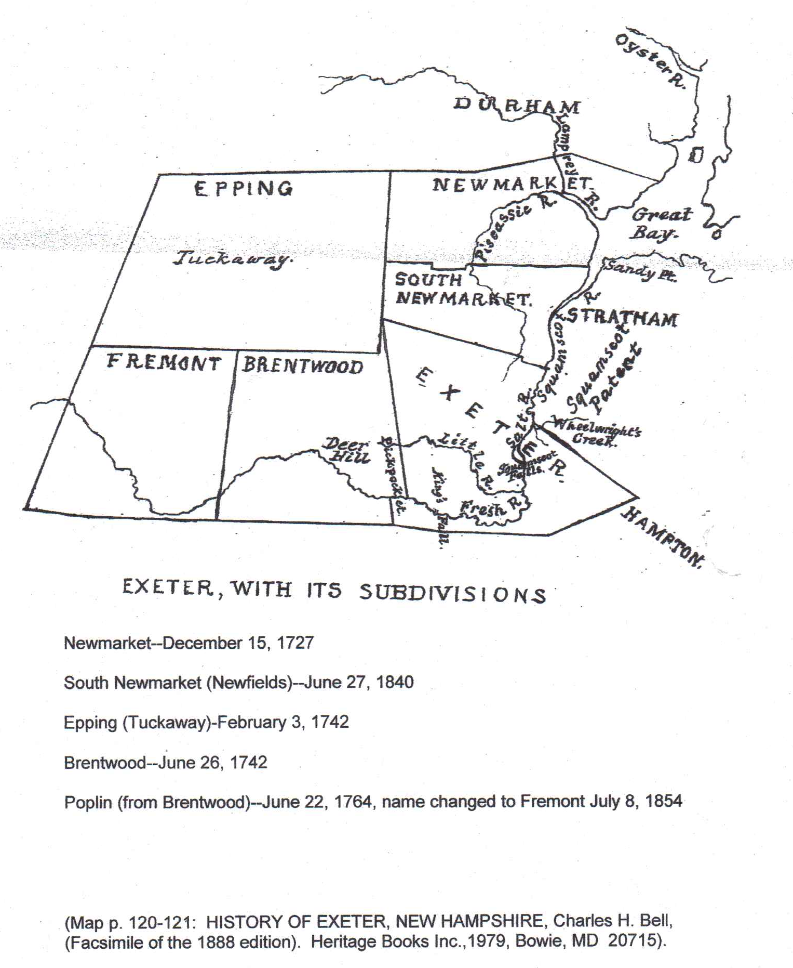

Slide 3
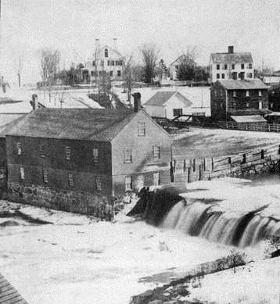
Founded April 3rd, 1638 after purchase of land from local Native Americans
Situated at the river falls providing sources for farming and access to trade routes
Combination signed July 4, 1639 and then established the Town’s form of Government – Board of Selectmen and legislative body
1640’s to mid 1800’s predominantly fish an timber adding saw mills, shipbuilding and associated manufacturing, trade goods
1640 - First mill established for grinding grain by Thomas Wilson (String Bridge)
1648 - First saw mill established by Edward Gilman, Jr. (Great Bridge)
Trade goods and supplies from Stawbery Banke
Population 175

Slide 4
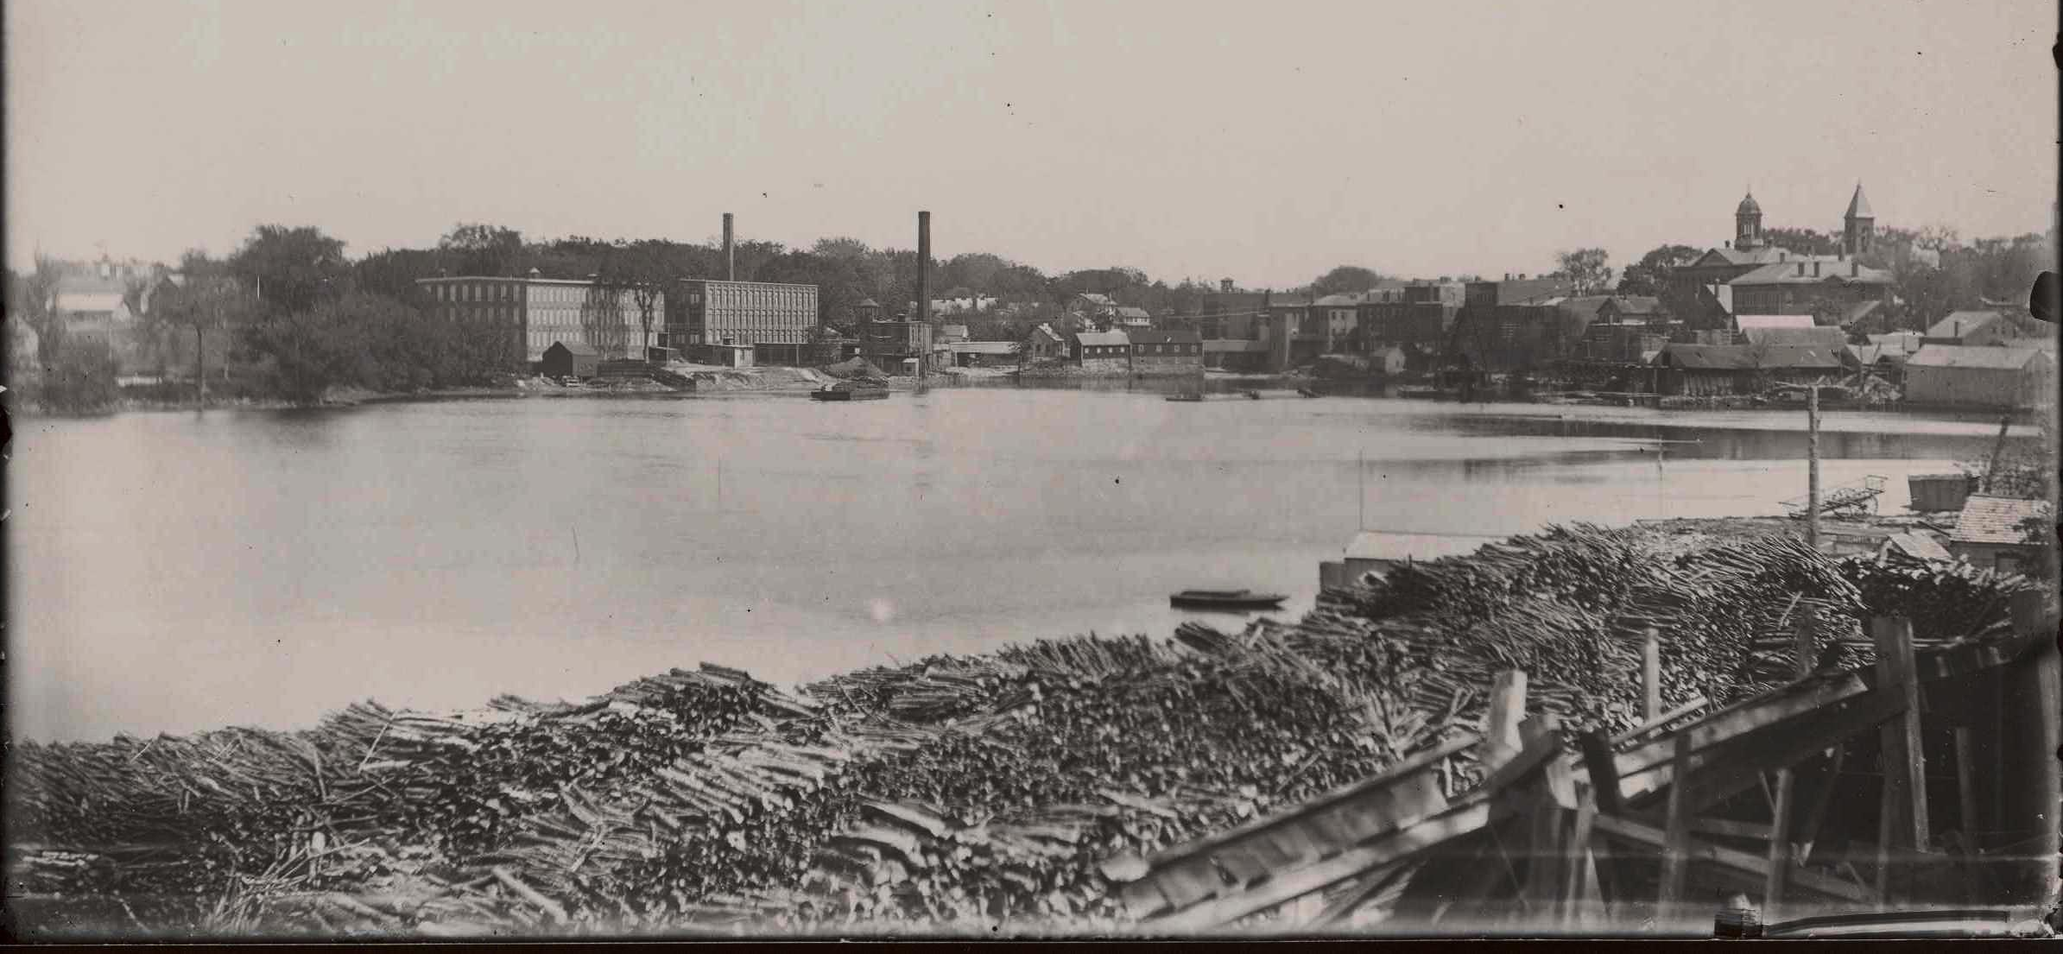
Mid 1700’s
Farming
Government involvement
Printing, Newspapers
Population over 1,500
Example - Timber to be shipped or milled

Slide 5
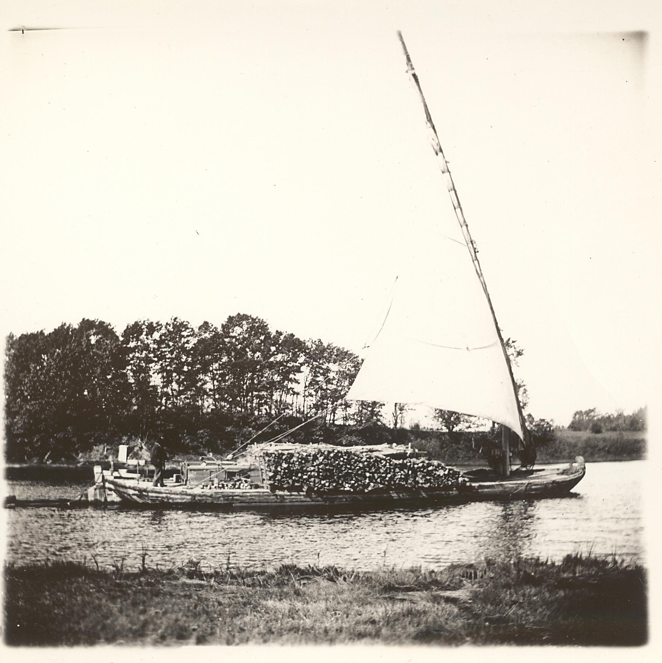
Example
Gundalow moving timber downstream to Great Bay

Slide 6
Exeter 1770’s to 1800
Most subdivisions have been established
Phillips Exeter Academy established 1789
Capitol of New Hampshire
First reading of the Declaration of Independence, July 18th, 1776
Home to the State Treasury and Legislature
9th State to ratify the Constitution
Increase in types of mills and trade goods
Gun Powder, Paper, Nails

Slide 7
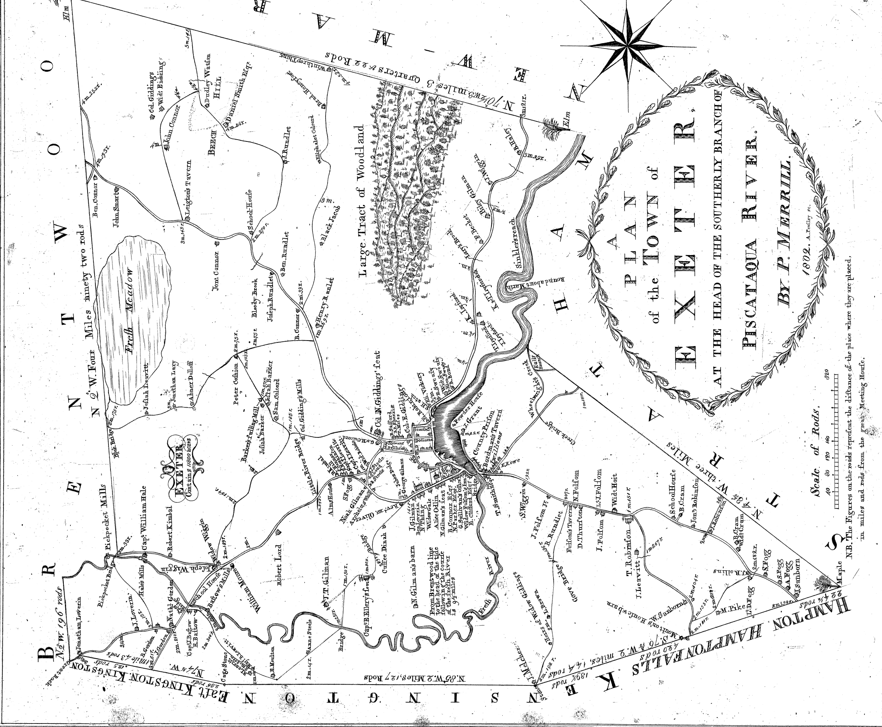
Settlement expands and infills west along river
Farming increases surrounding center and continues west to forested areas
Highway access to Portsmouth, Hampton, Brentwood, Epping and Kingston
1802

Slide 8
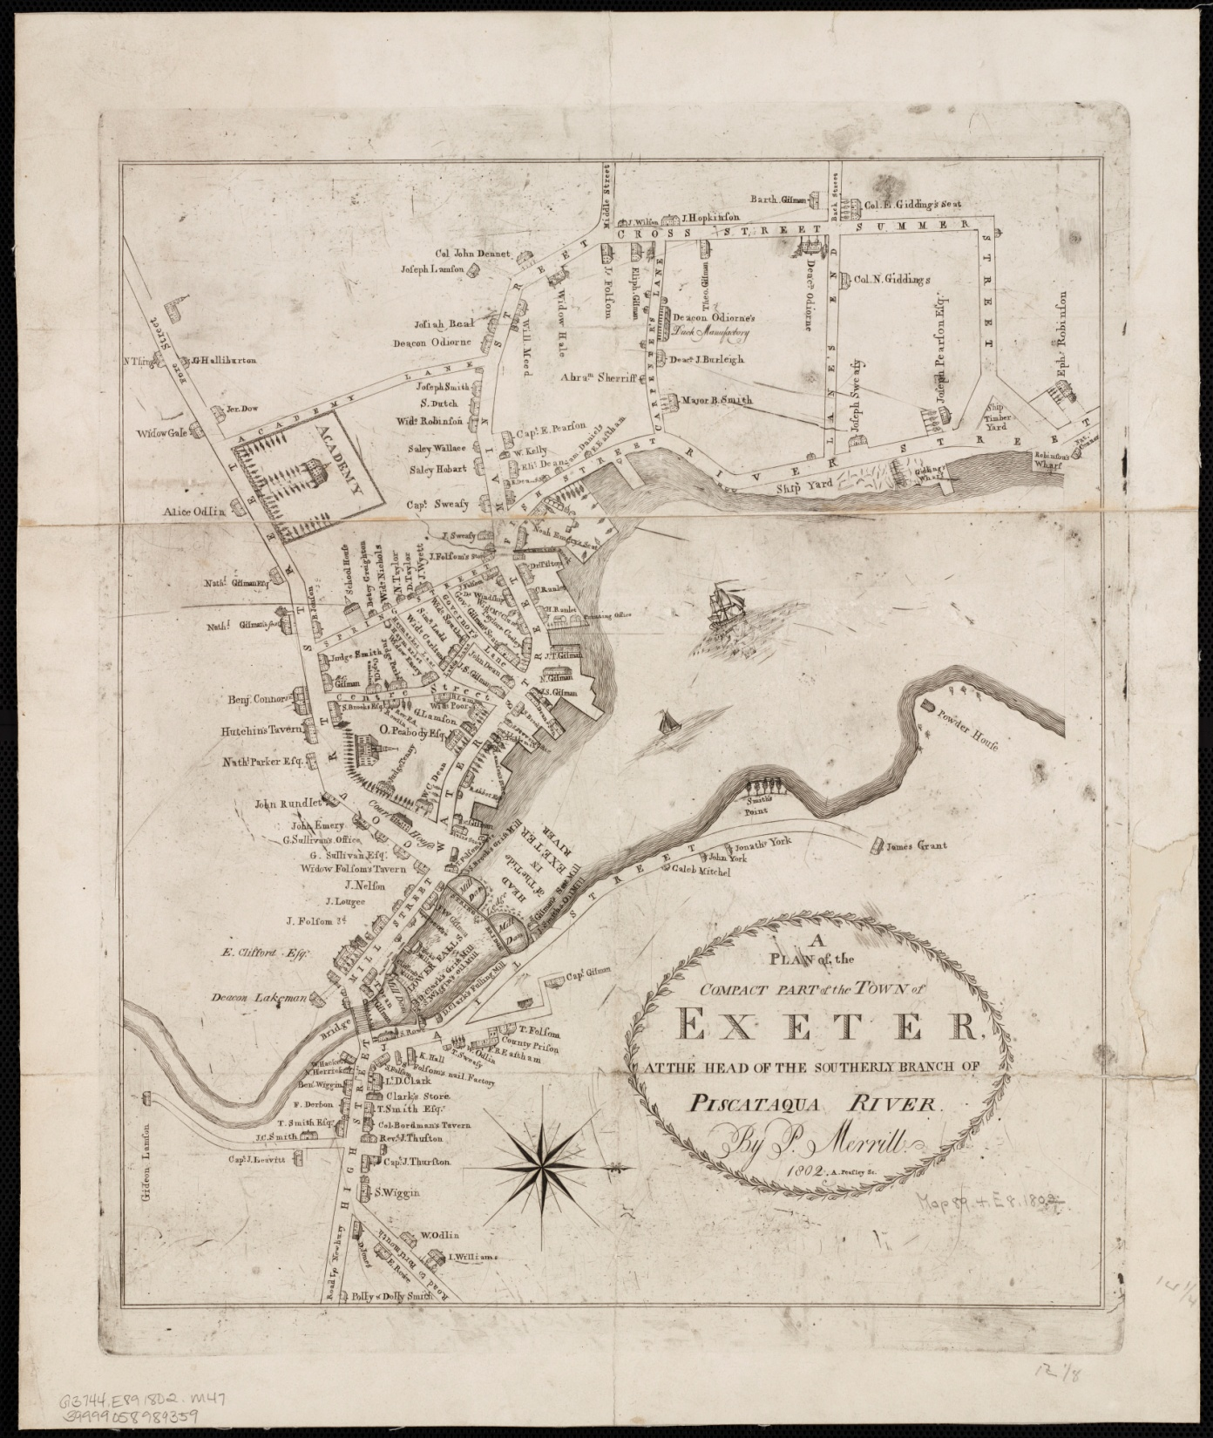
Mills and wharves along the river included: fulling, linseed oil, lumber, Ship building
Land’s End (now Park St.)
main delivery point for timber
Supporting businesses
Continued development in downtown
Academy forms western edge of dense development
Cass, Park and Summer Streets begin infill development
Water Street built up to avoid flooding
First Bank 1803
1802

Slide 9
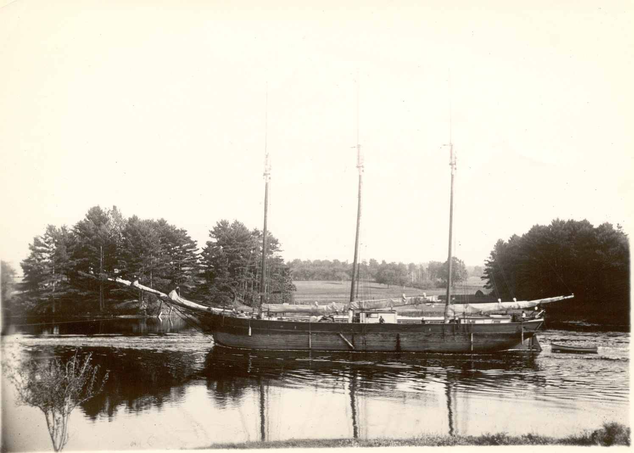
Example
Schooner on the Squamscott

Slide 10
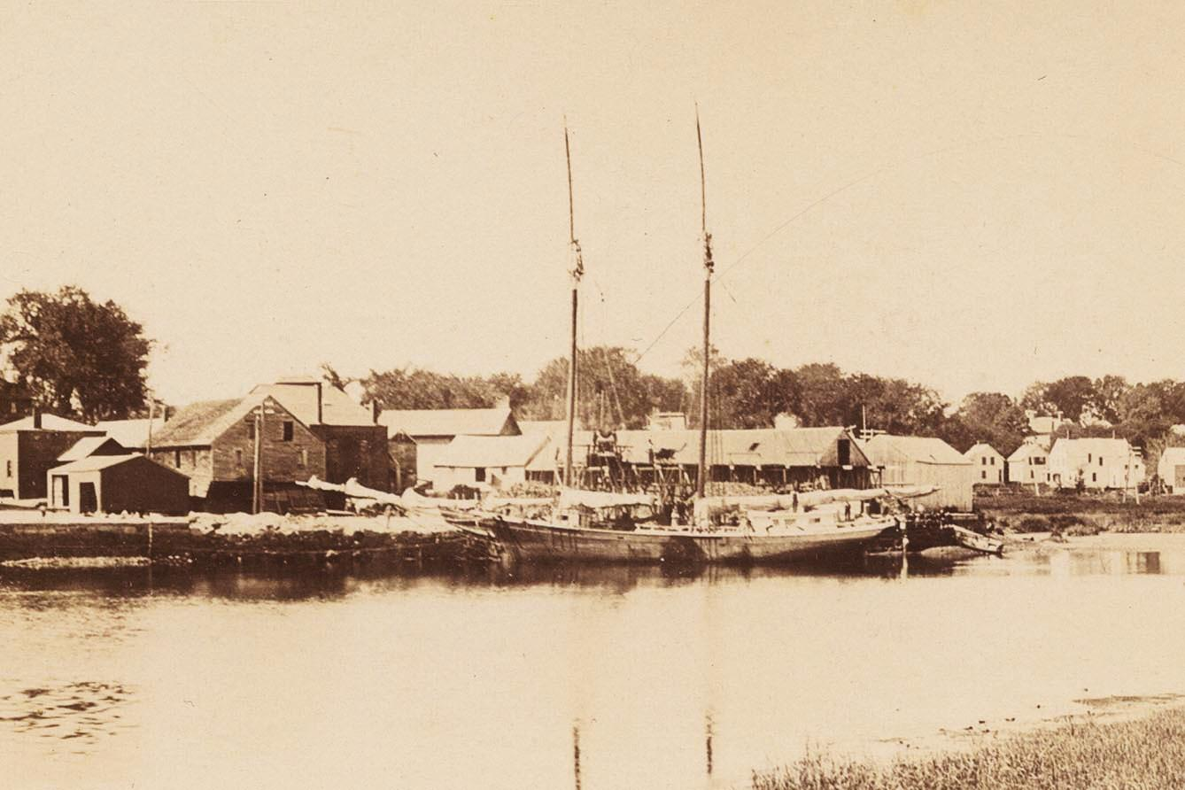
Sample
Schooner on the Squamscott

Slide 11
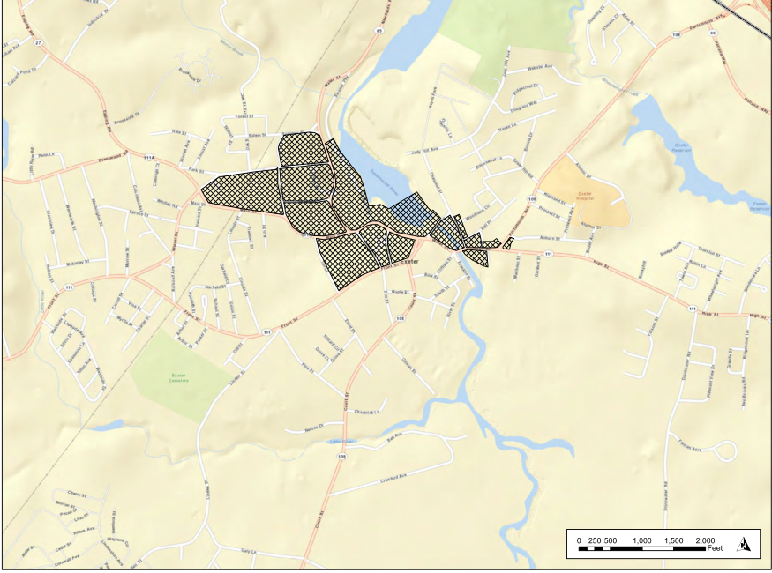
Population 1,722
1776-1830
gun powder
nails
pottery sailcloth tanneries saddlery carriages
hats
boxes
brickyards brass works machine works
Boots
shoes
cotton cloth
1801 a private enterprise bringing spring water in underground wooden pipes to some houses
1823 - police force
1802
1802

Slide 12
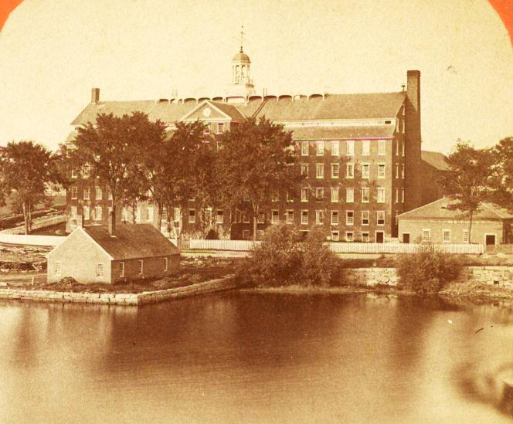
1830
Population 2,795
Exeter Manufacturing Company water powered textile factory
Supporting industries:
machine manufacturing, starch, fulling
1831 - Printing and publishing – first Exeter News-Letter
1839 - Last boat launch
1840 – Powder mill explosion

Slide 13
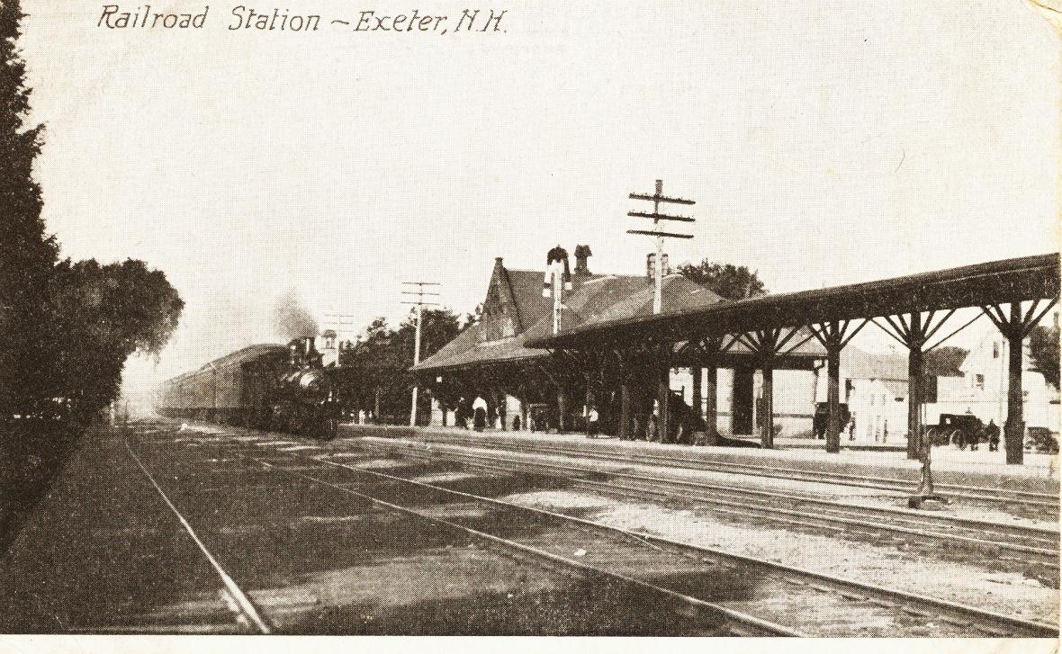
1841
Boston and Maine railroad comes to Exeter
Opens west side to development
Direct connection to Boston for both passenger and commercial trains
Dense growth on east end with carriage, wagon making
Work force housing
1st station at Front Street spanned the tracks.
½ of the building still exists on Arbor Street
2nd on Lincoln Street. Burned during renovations.
3rd of Exeter’s three rail stations.

Slide 14
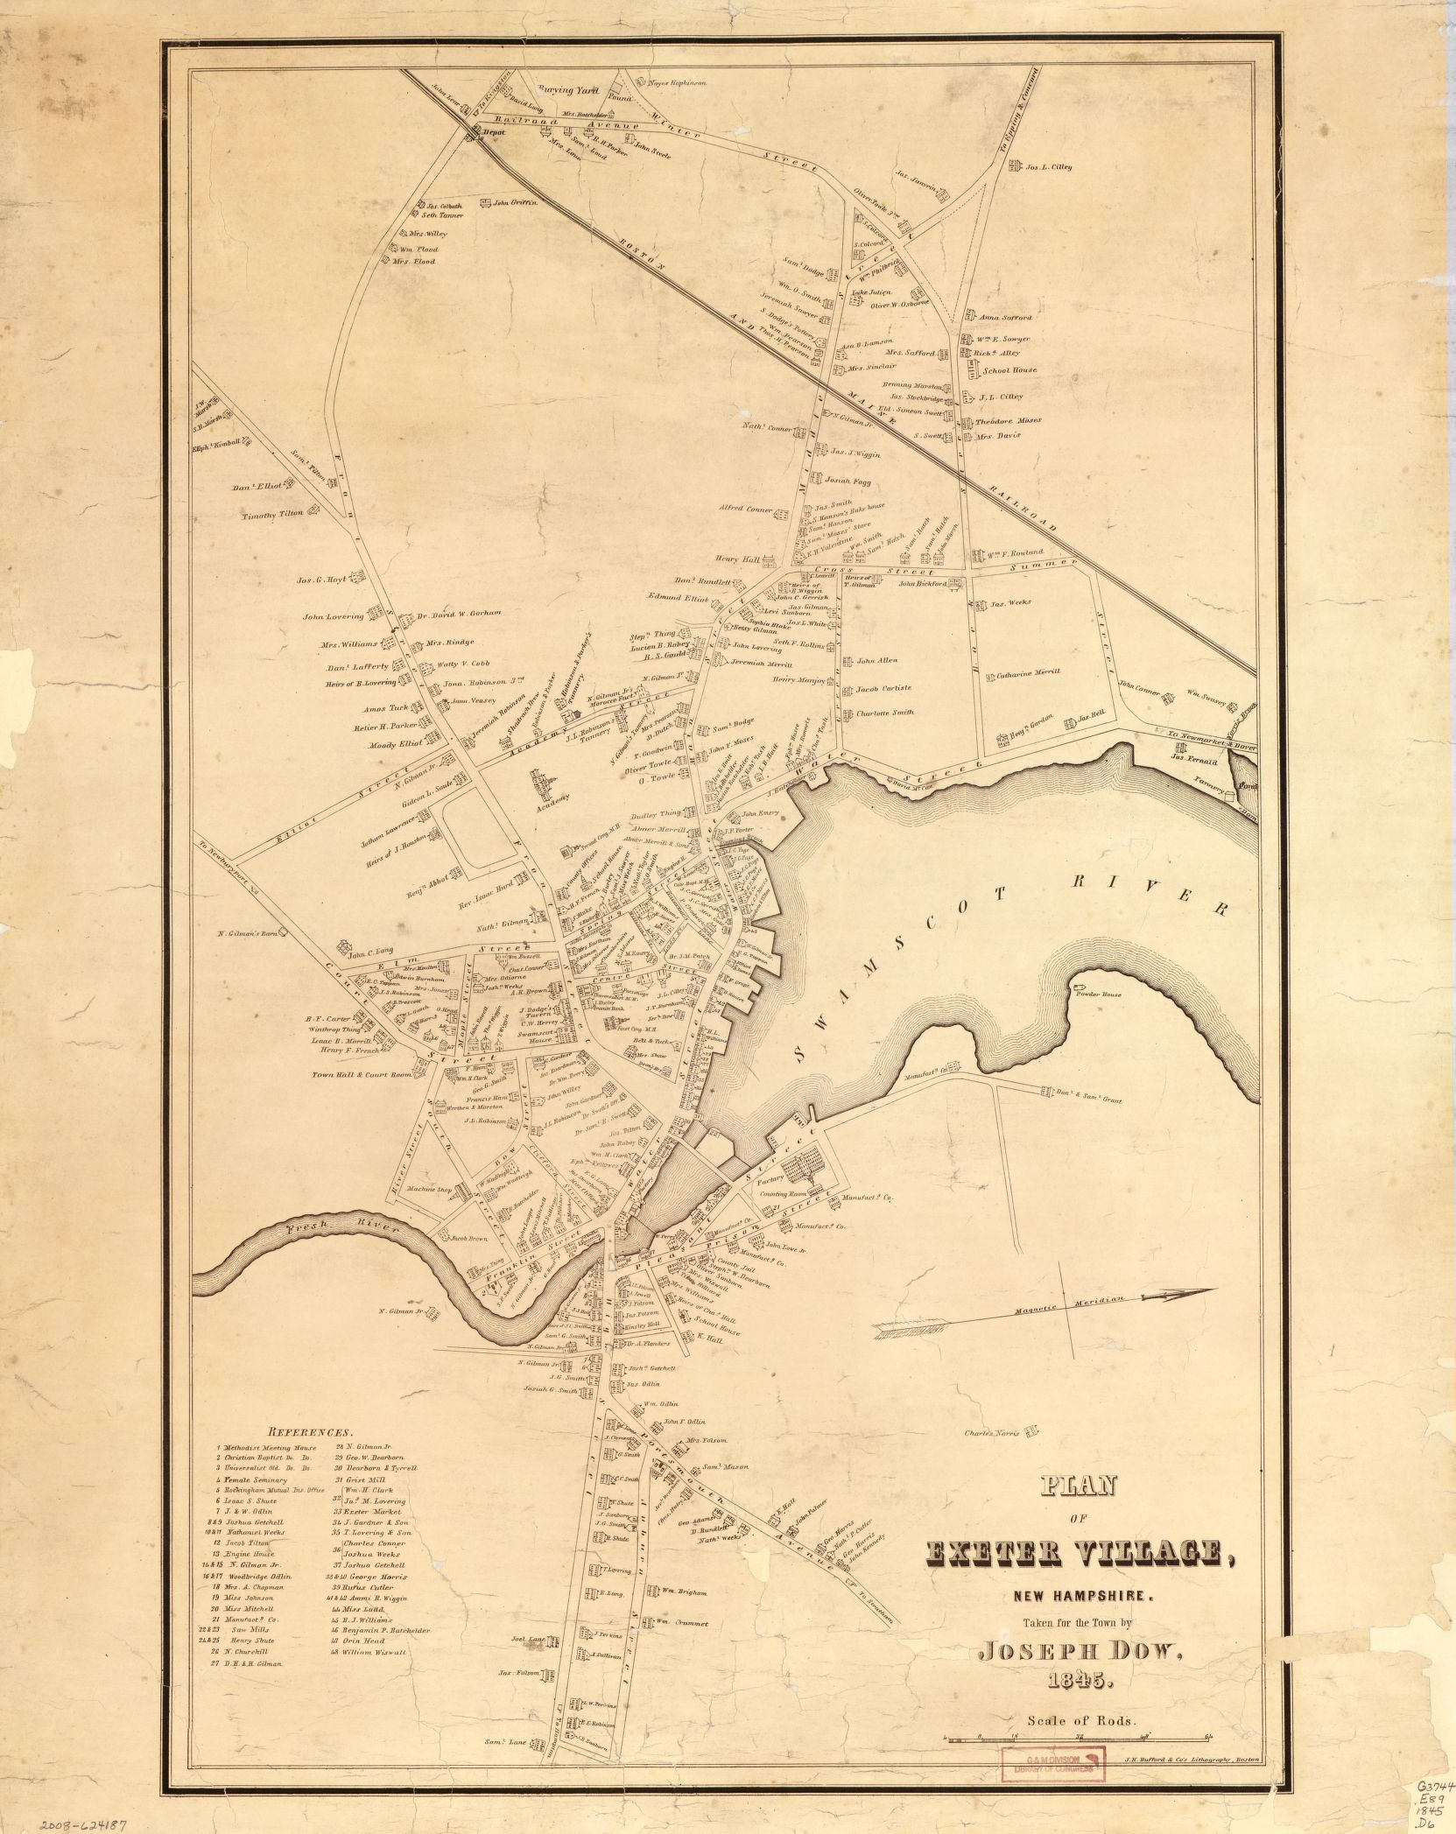
Wagon and carriage making with supporting machining, smithing, painting,
tanning
1845
1845

Slide 15
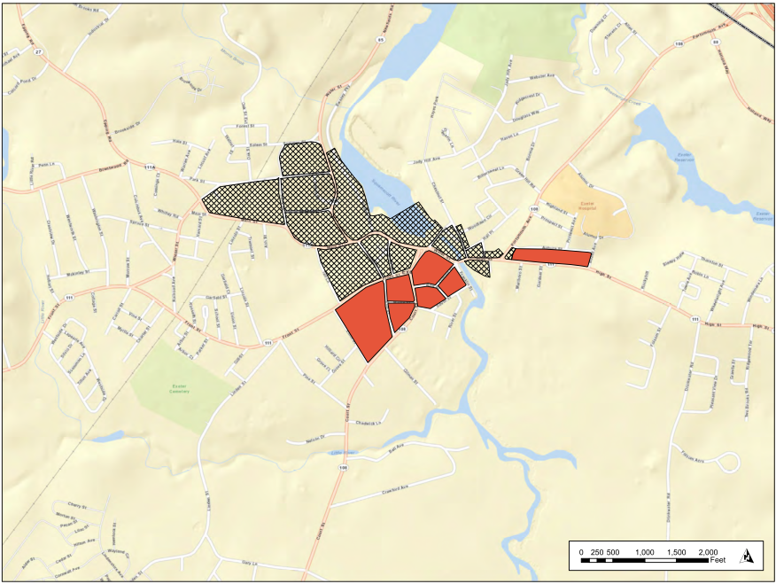
1845
Population 3,329
1845

Slide 16
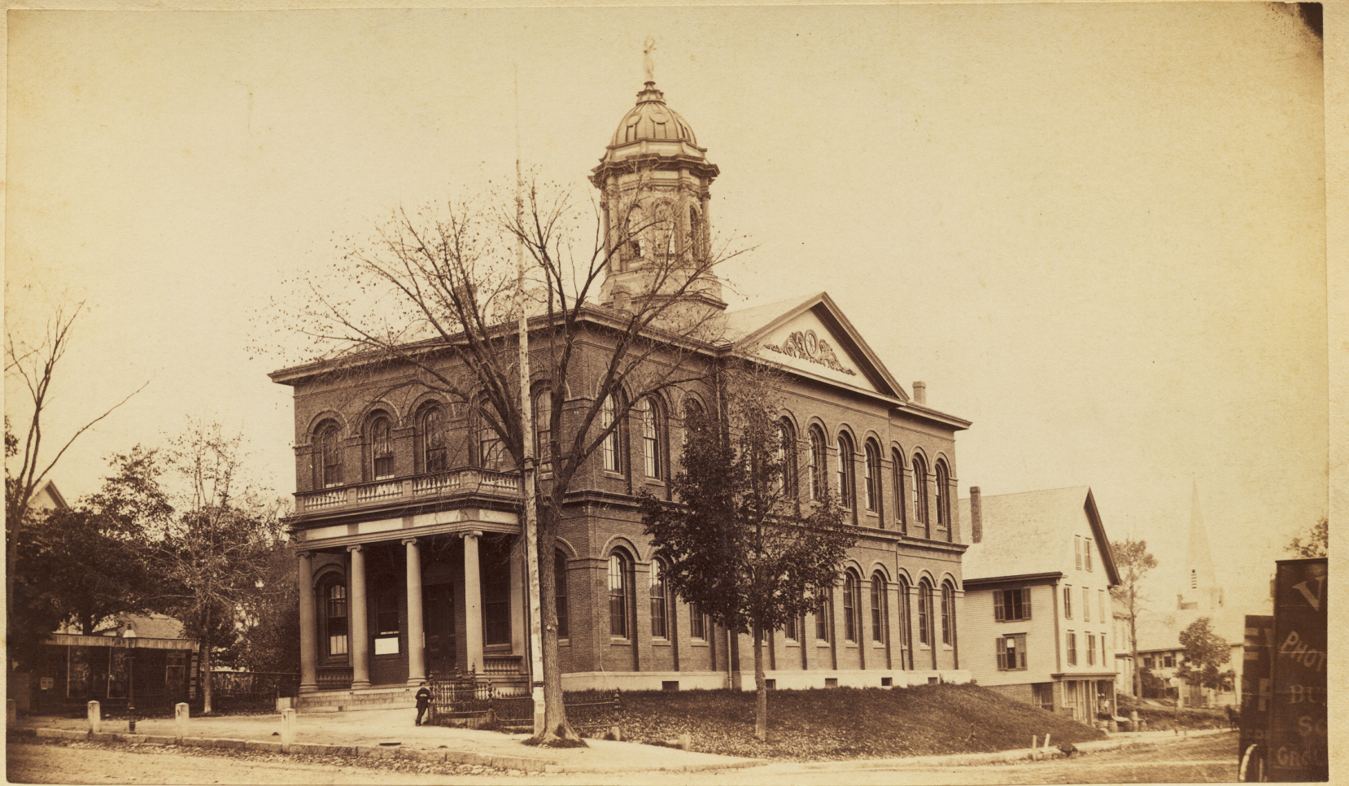
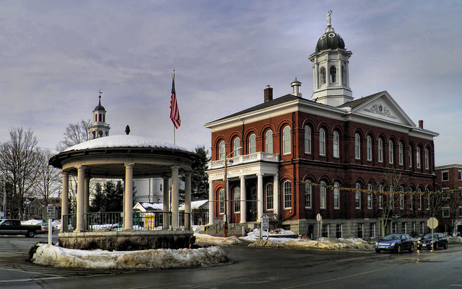
1850’s
1853 - public library
Exeter Gas Light Co.
1855 - Town Hall
($30,000)
1867 – Robinson Female Seminary

Slide 17
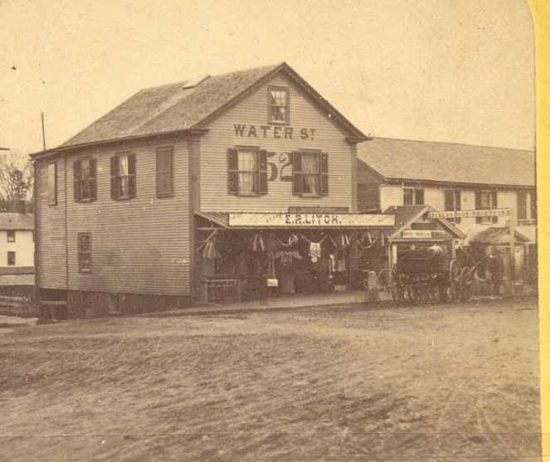
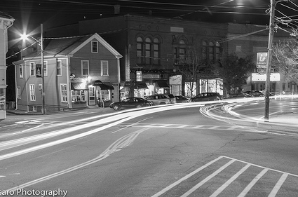
1870’s
Downtown is prosperous. Shop owners provide goods and services of all varieties.
Businesses along Water Street include
grocers, druggists, miliners
1871 began upgrading gravel sidewalks with paving

Slide 18
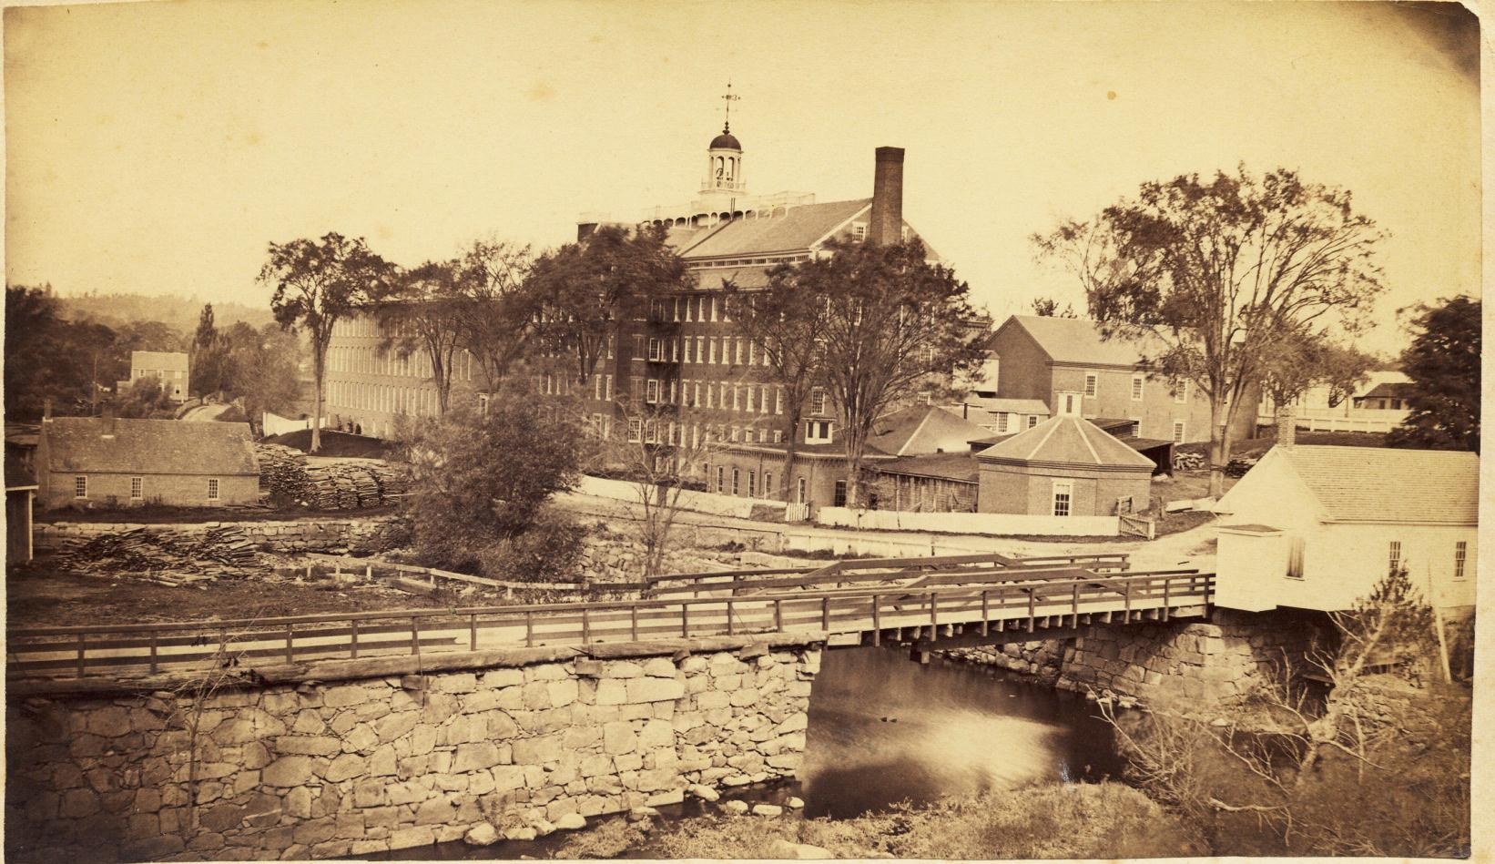
1871
Exeter Manufacturing Company
builds extension
adds steam power

Slide 19
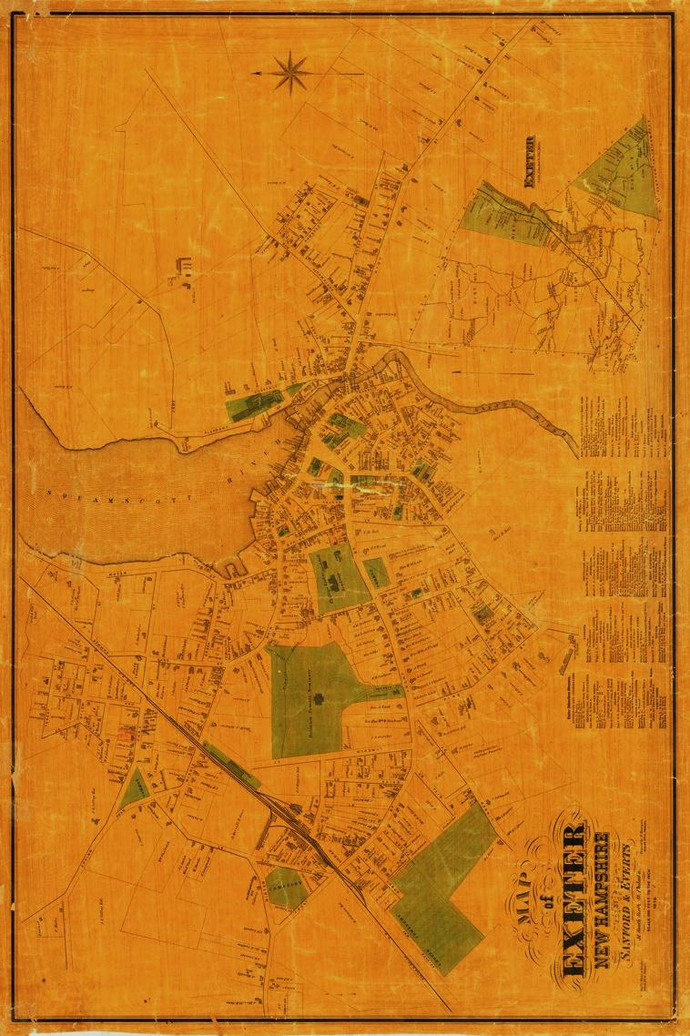
1874
Notes:
1880’s carriage, wagons livery blacksmithing painting

Slide 20
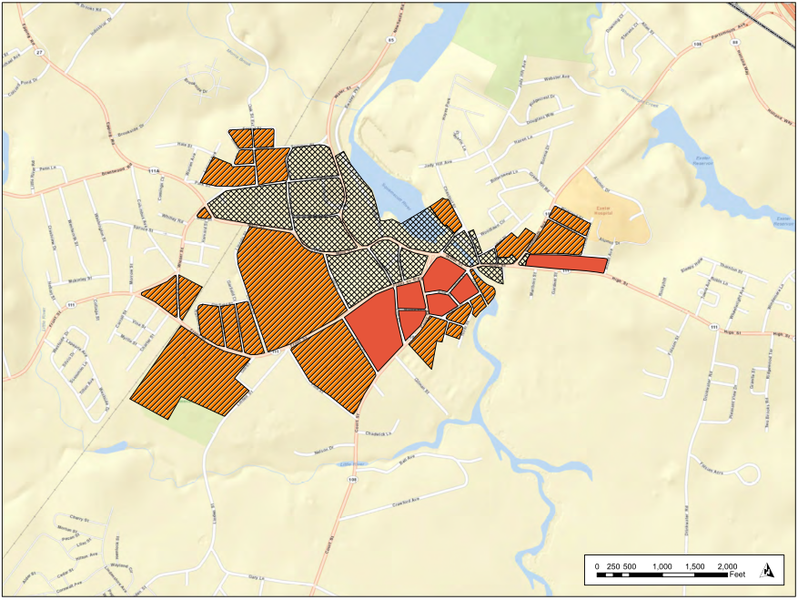
1874
Population 3,347
1874

Slide 21
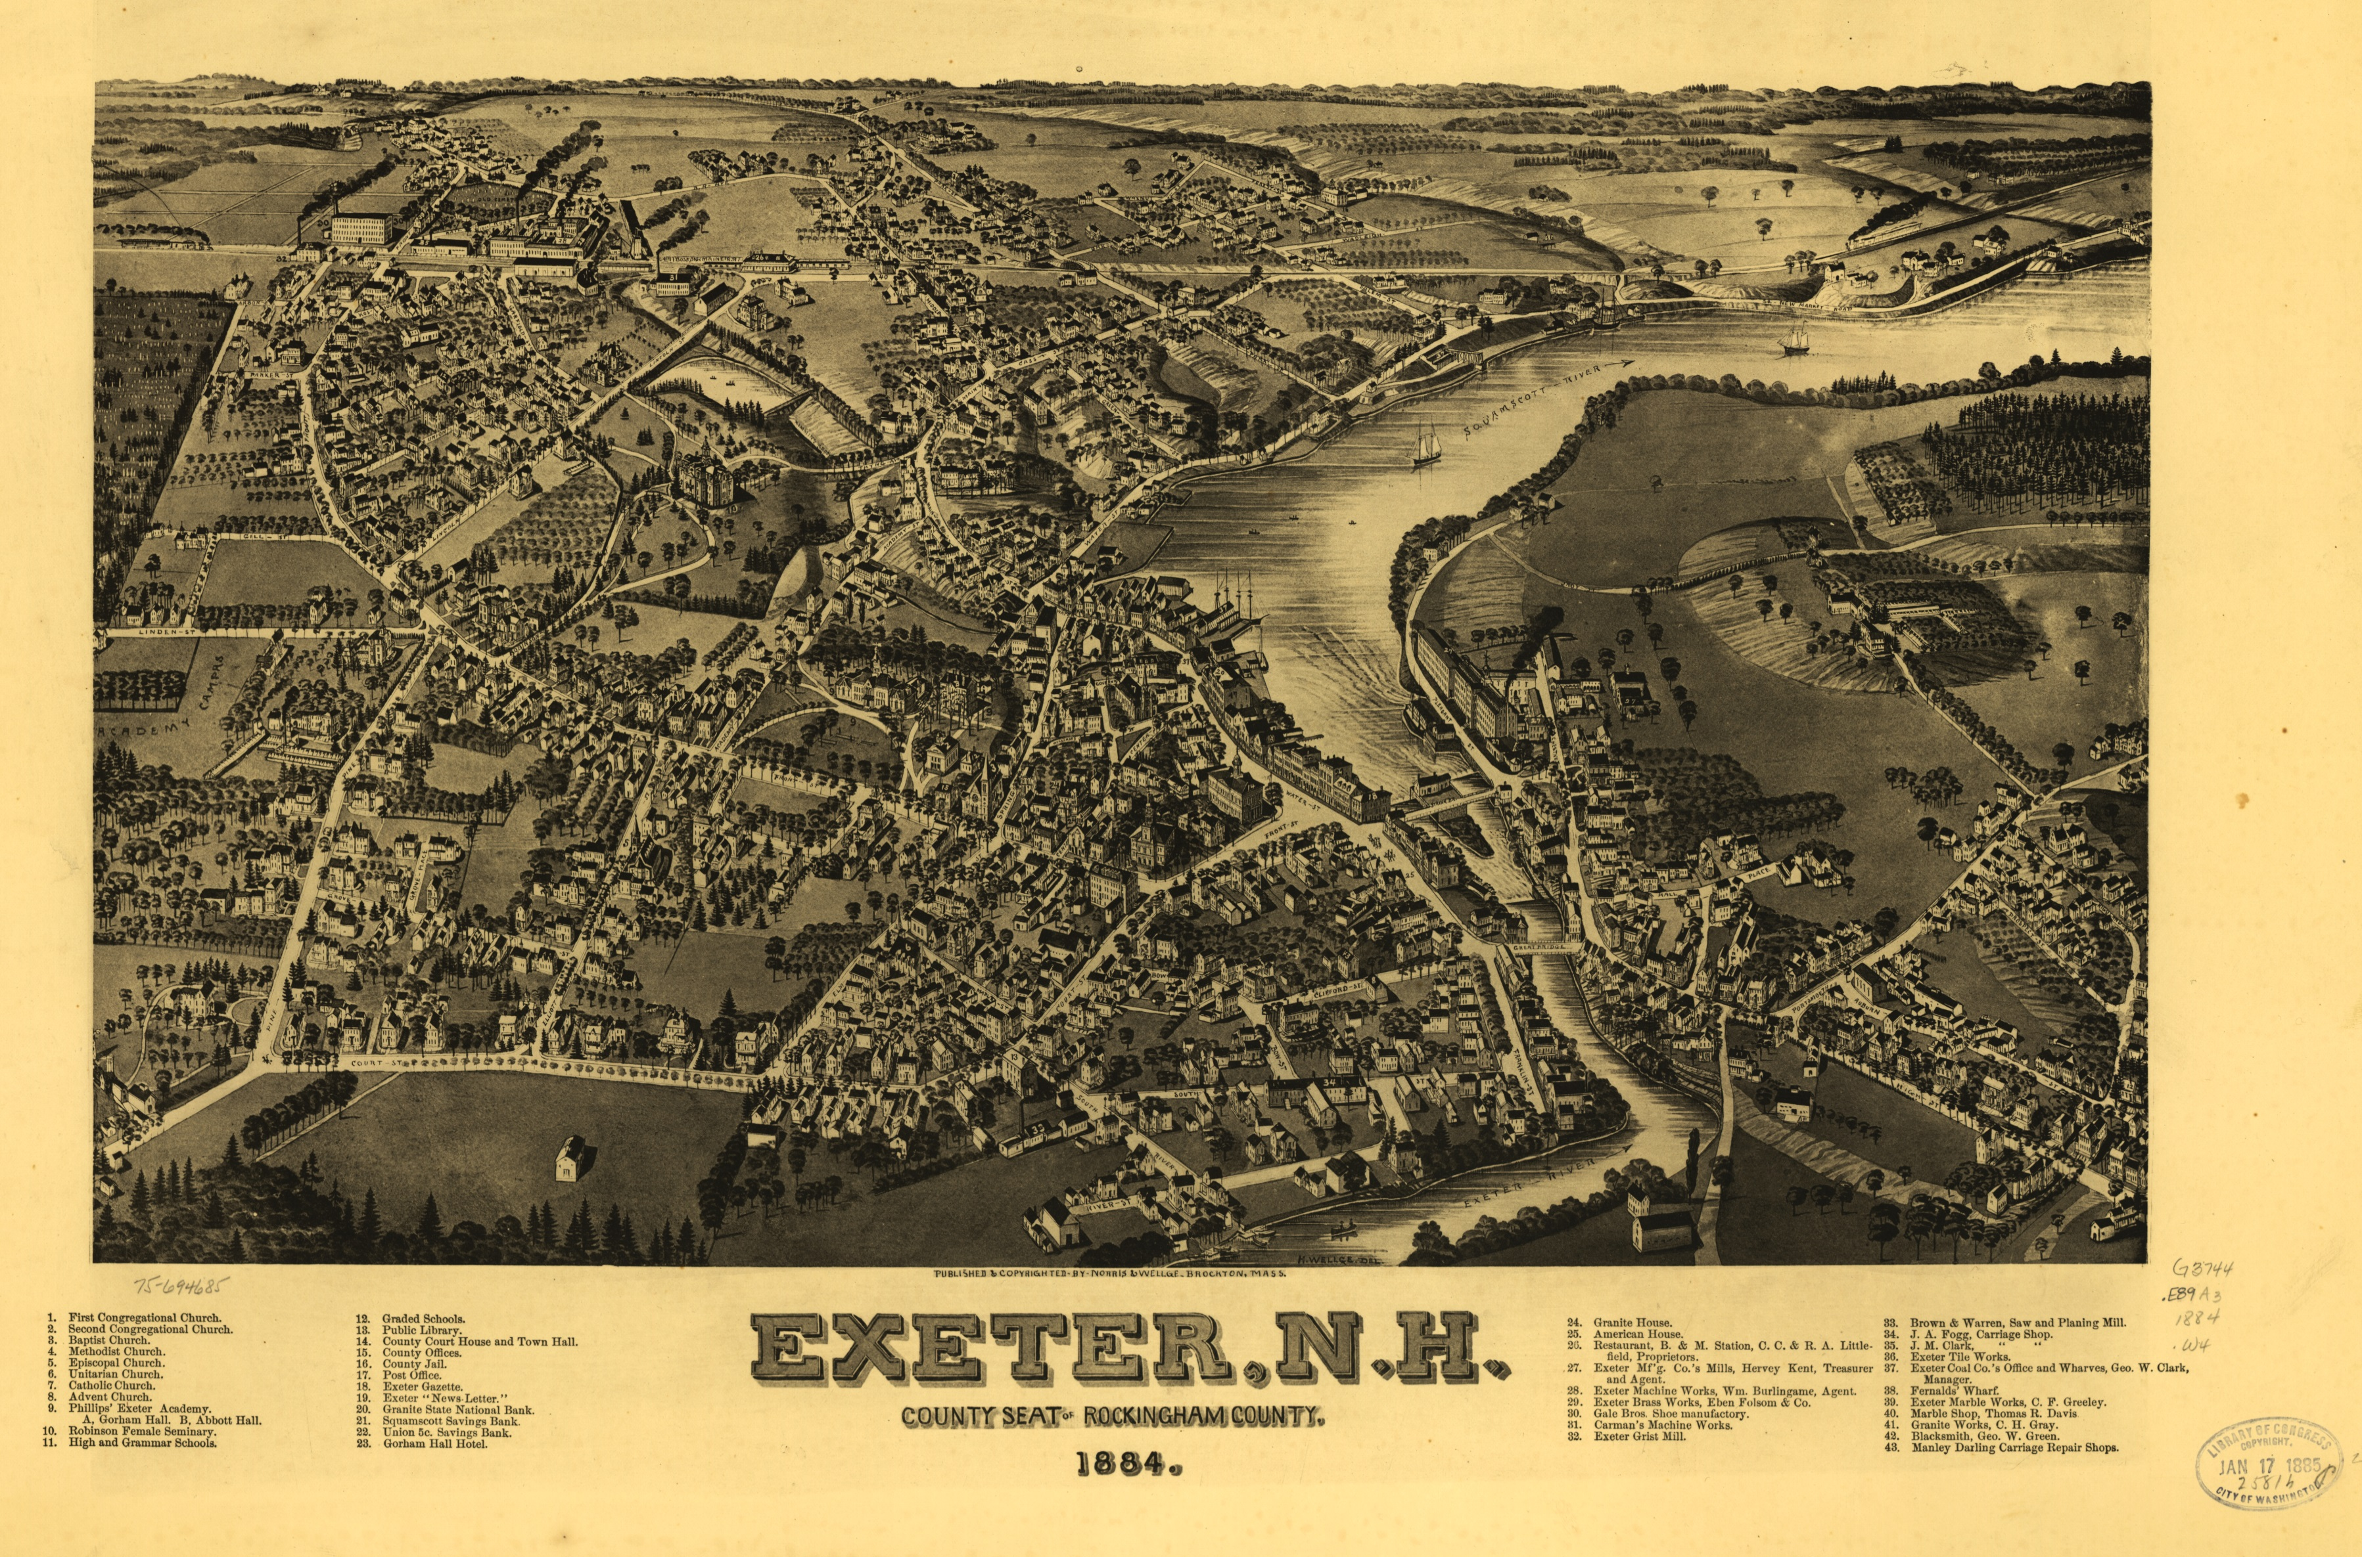
1884

Slide 22
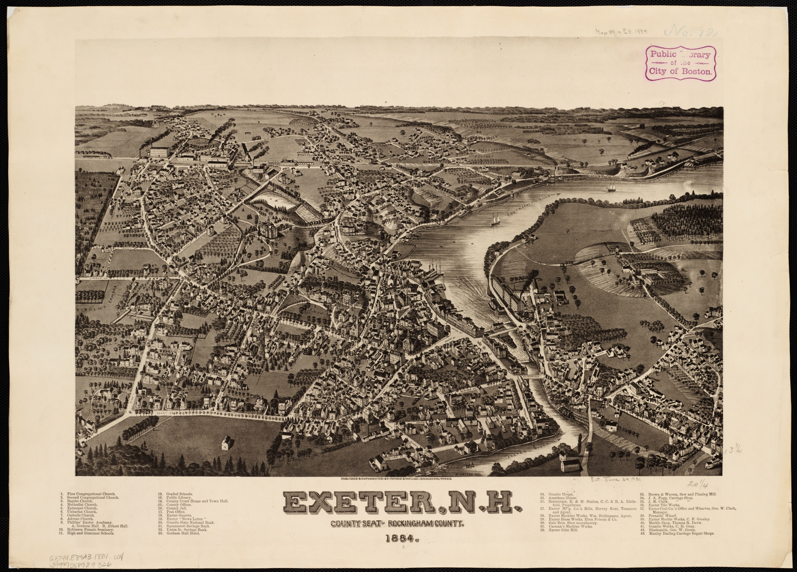
1884

Slide 23
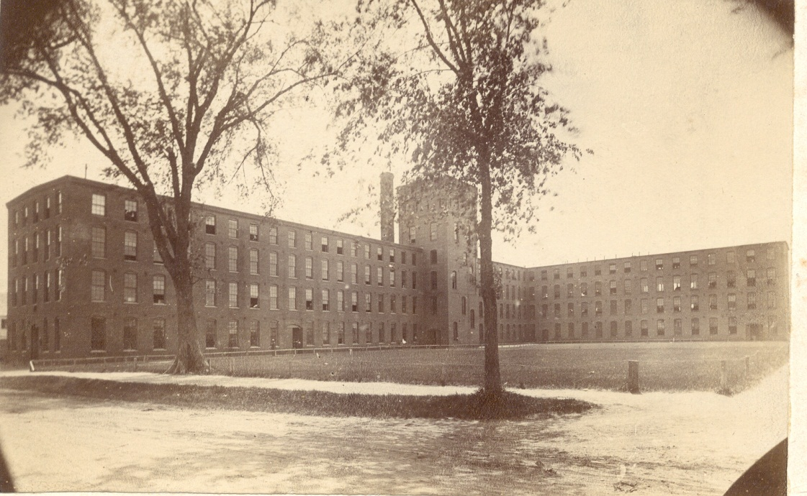
1884
Gale Brothers
Shoe and Boot Factory

Slide 24
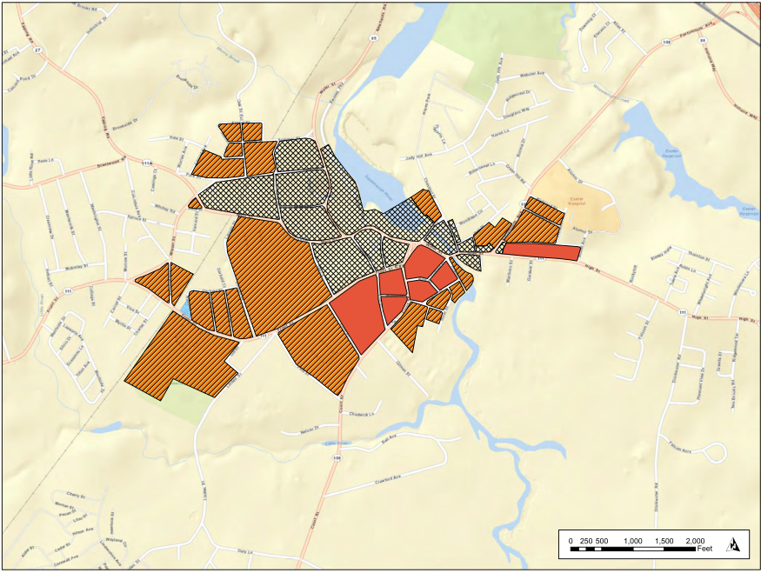
1885
Population 3,640
1885

Slide 25
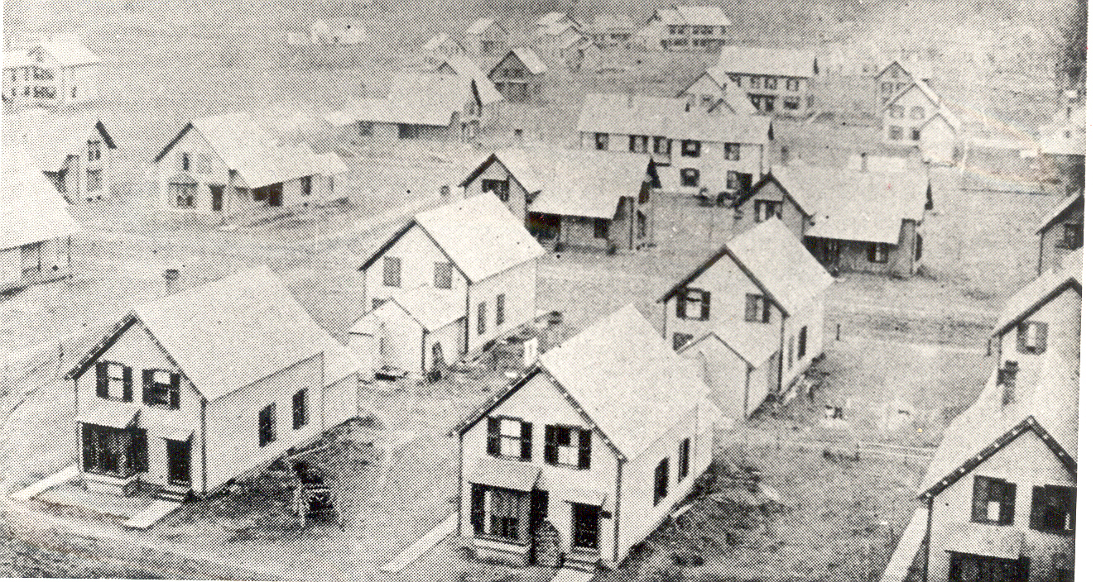
Worker Housing
Charter, Carol Street Area

Slide 26
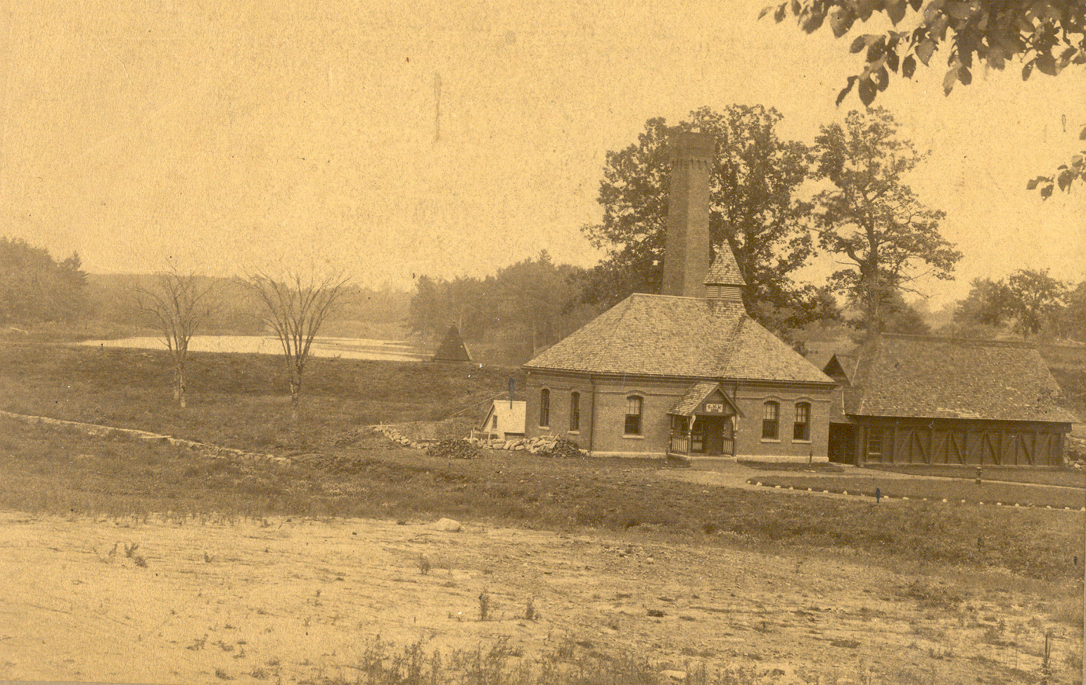
1887
Exeter Water Works Co. established at Wheelwright Creek.
intended to provide water for the whole town
Later sold to the Town
one steam-operated fire truck

Slide 27
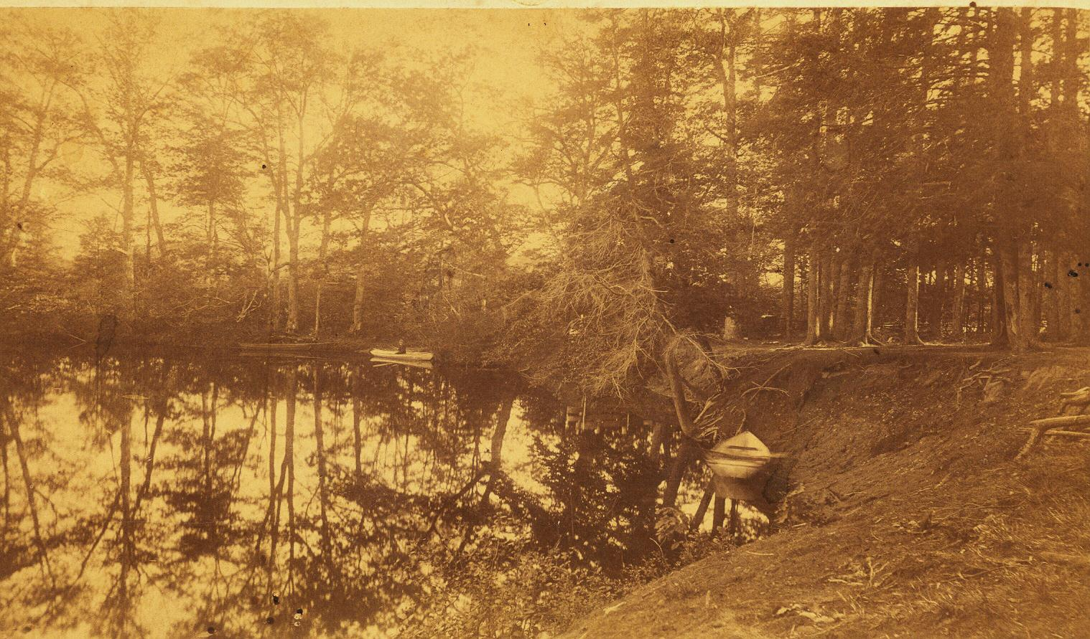
1891
Daniel Gilman donates land for Gilman Park

Slide 28
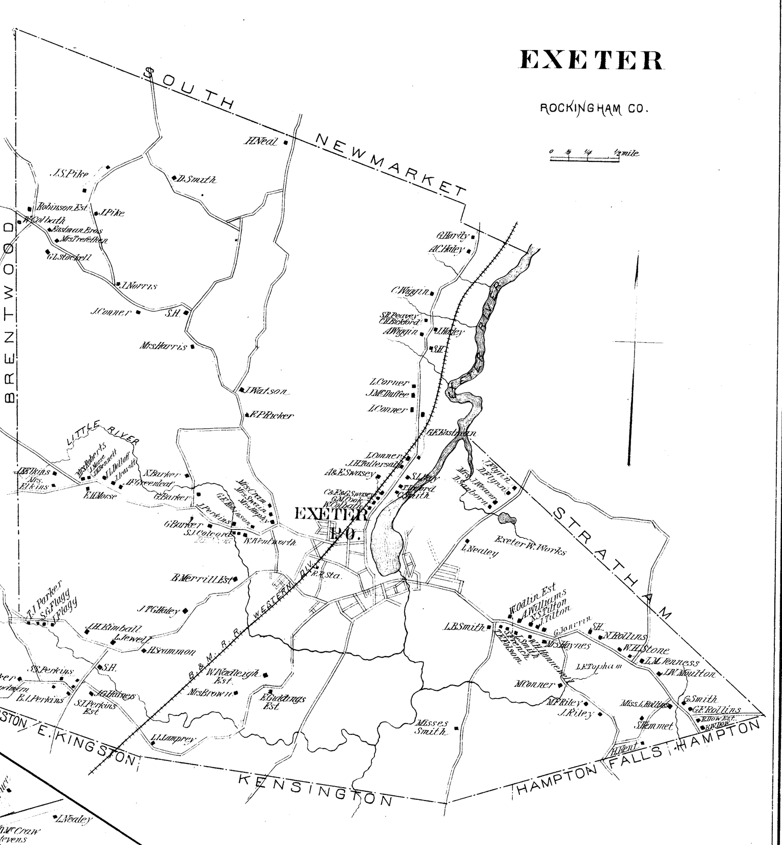
1892

Slide 29
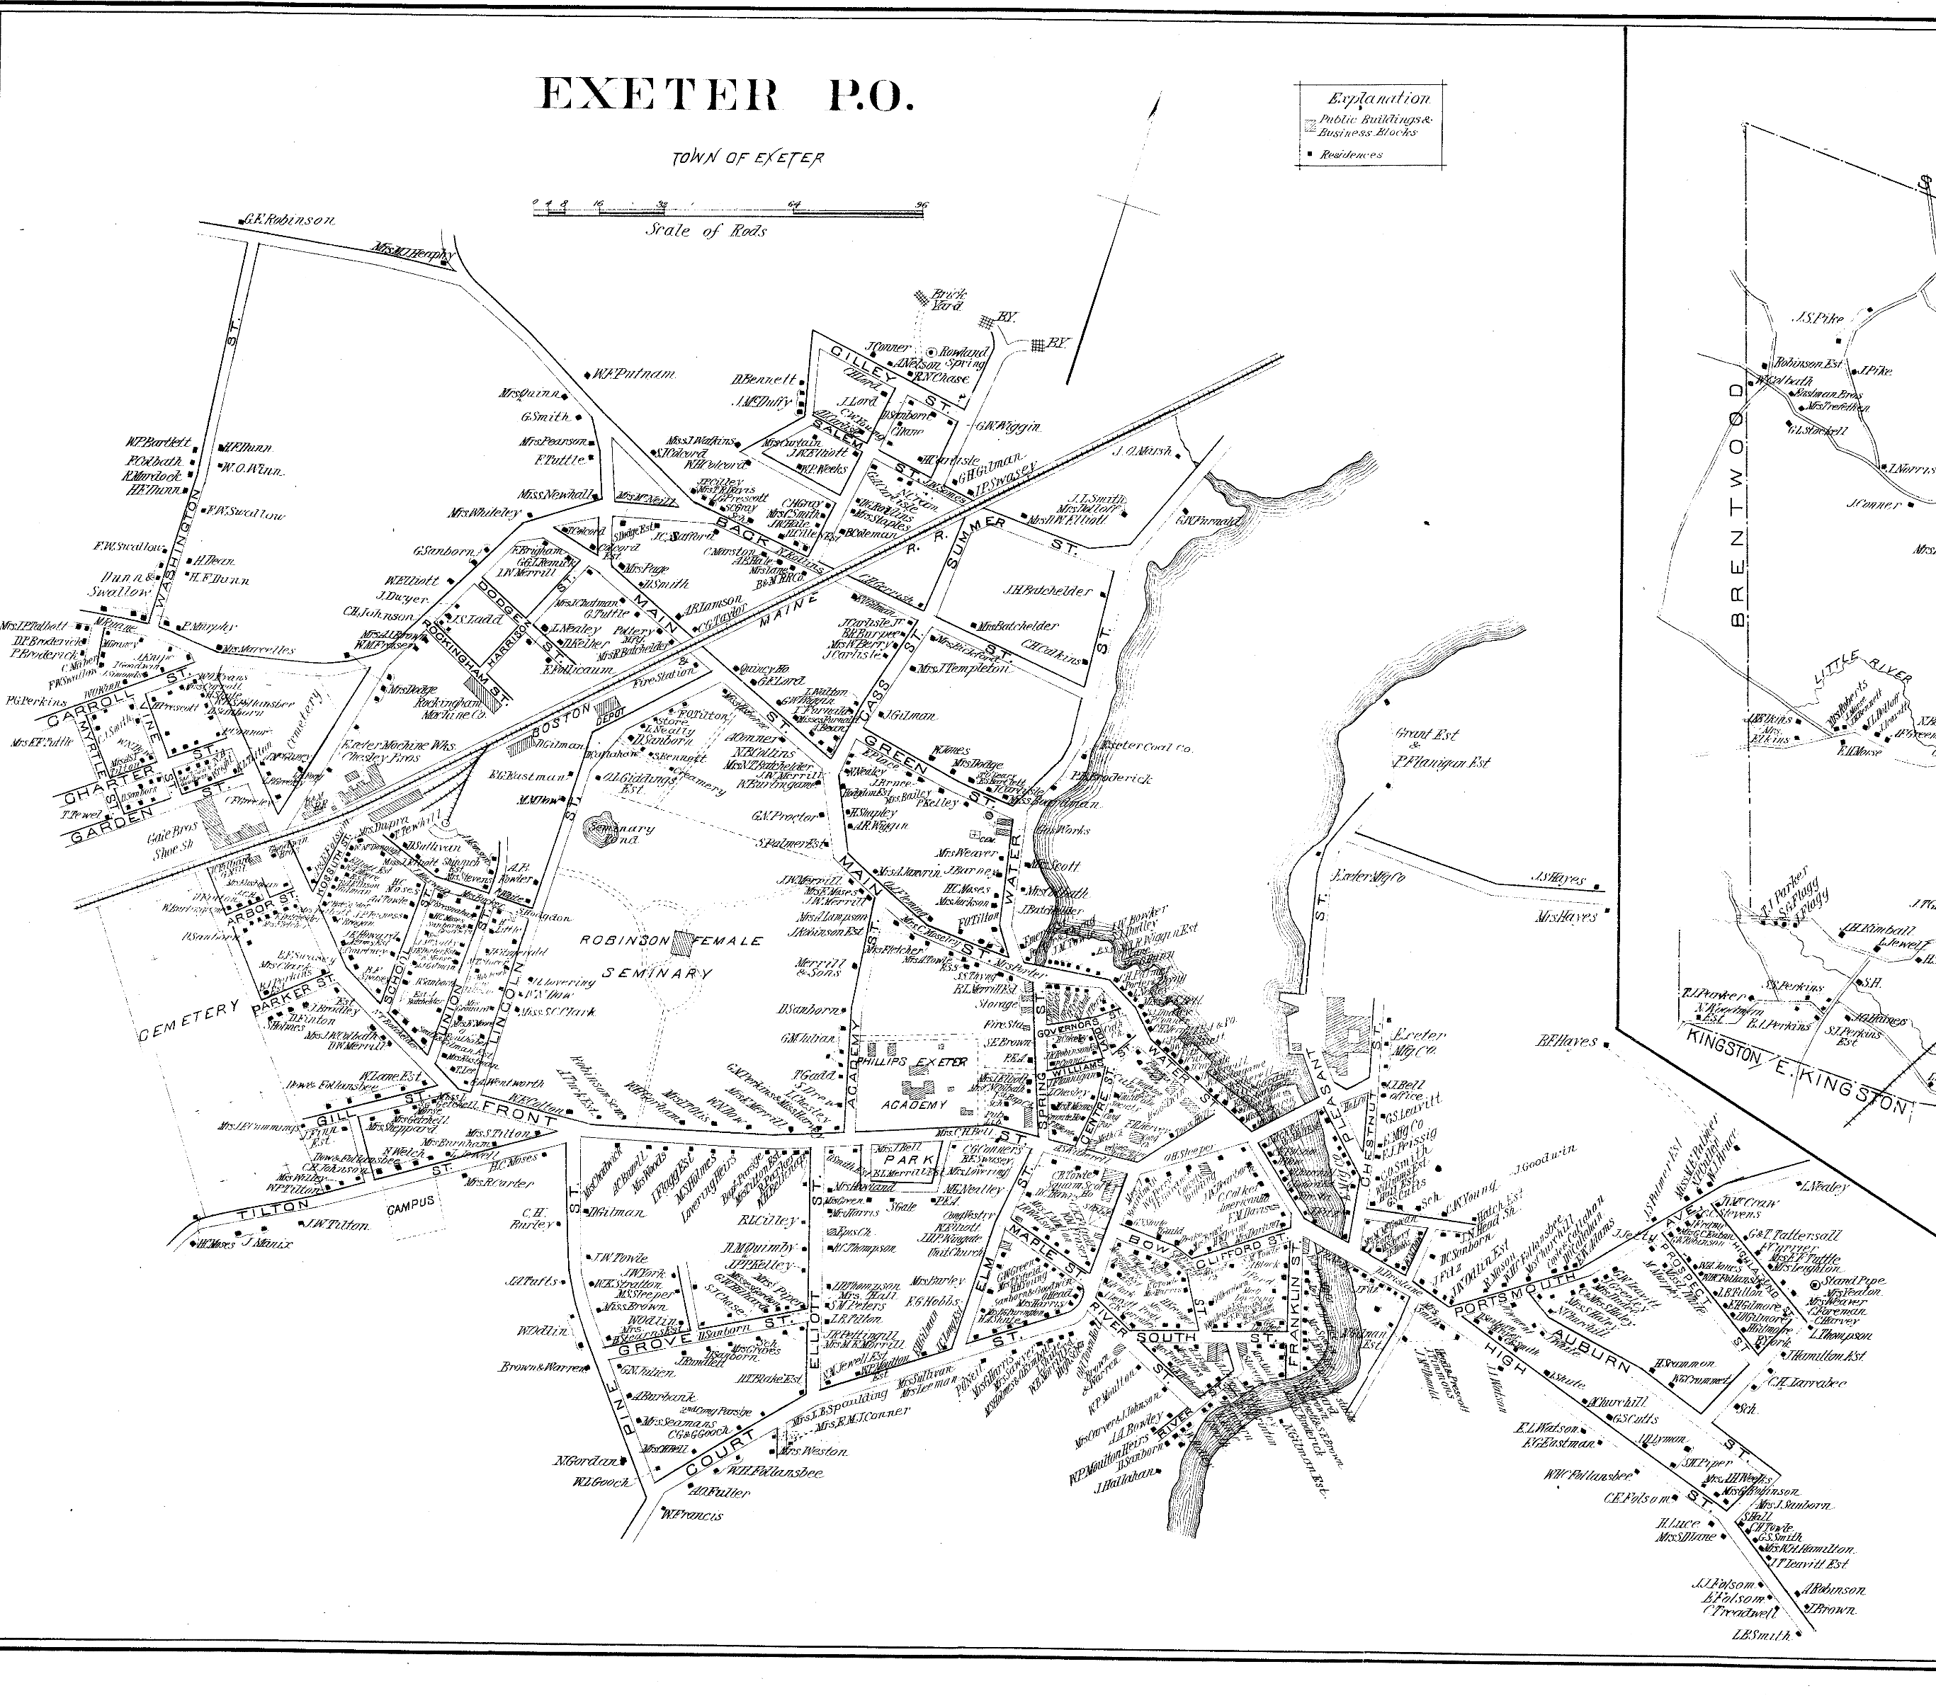
1890’s
Development extends and infills on High Street, Portsmouth Ave.,
Charter St., Carol St., Railroad Ave., Winter St., Dartmouth St.
County Courthouse

Slide 30
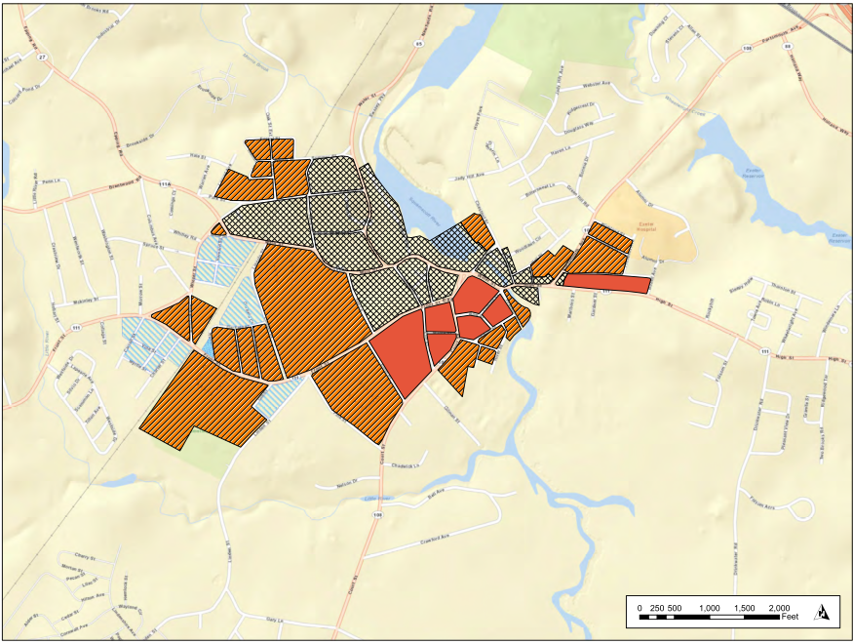
1892
Population 4,282
1892

Slide 31
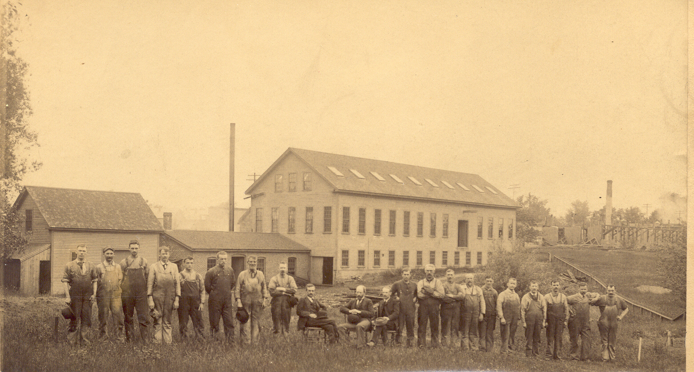
1892
Rubber Step Company

Slide 32
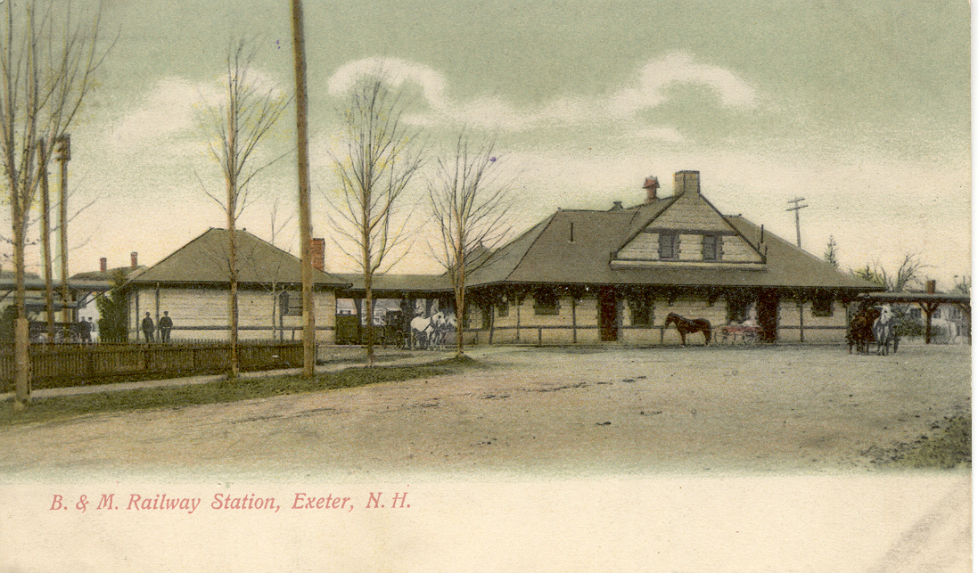
1892

Slide 33
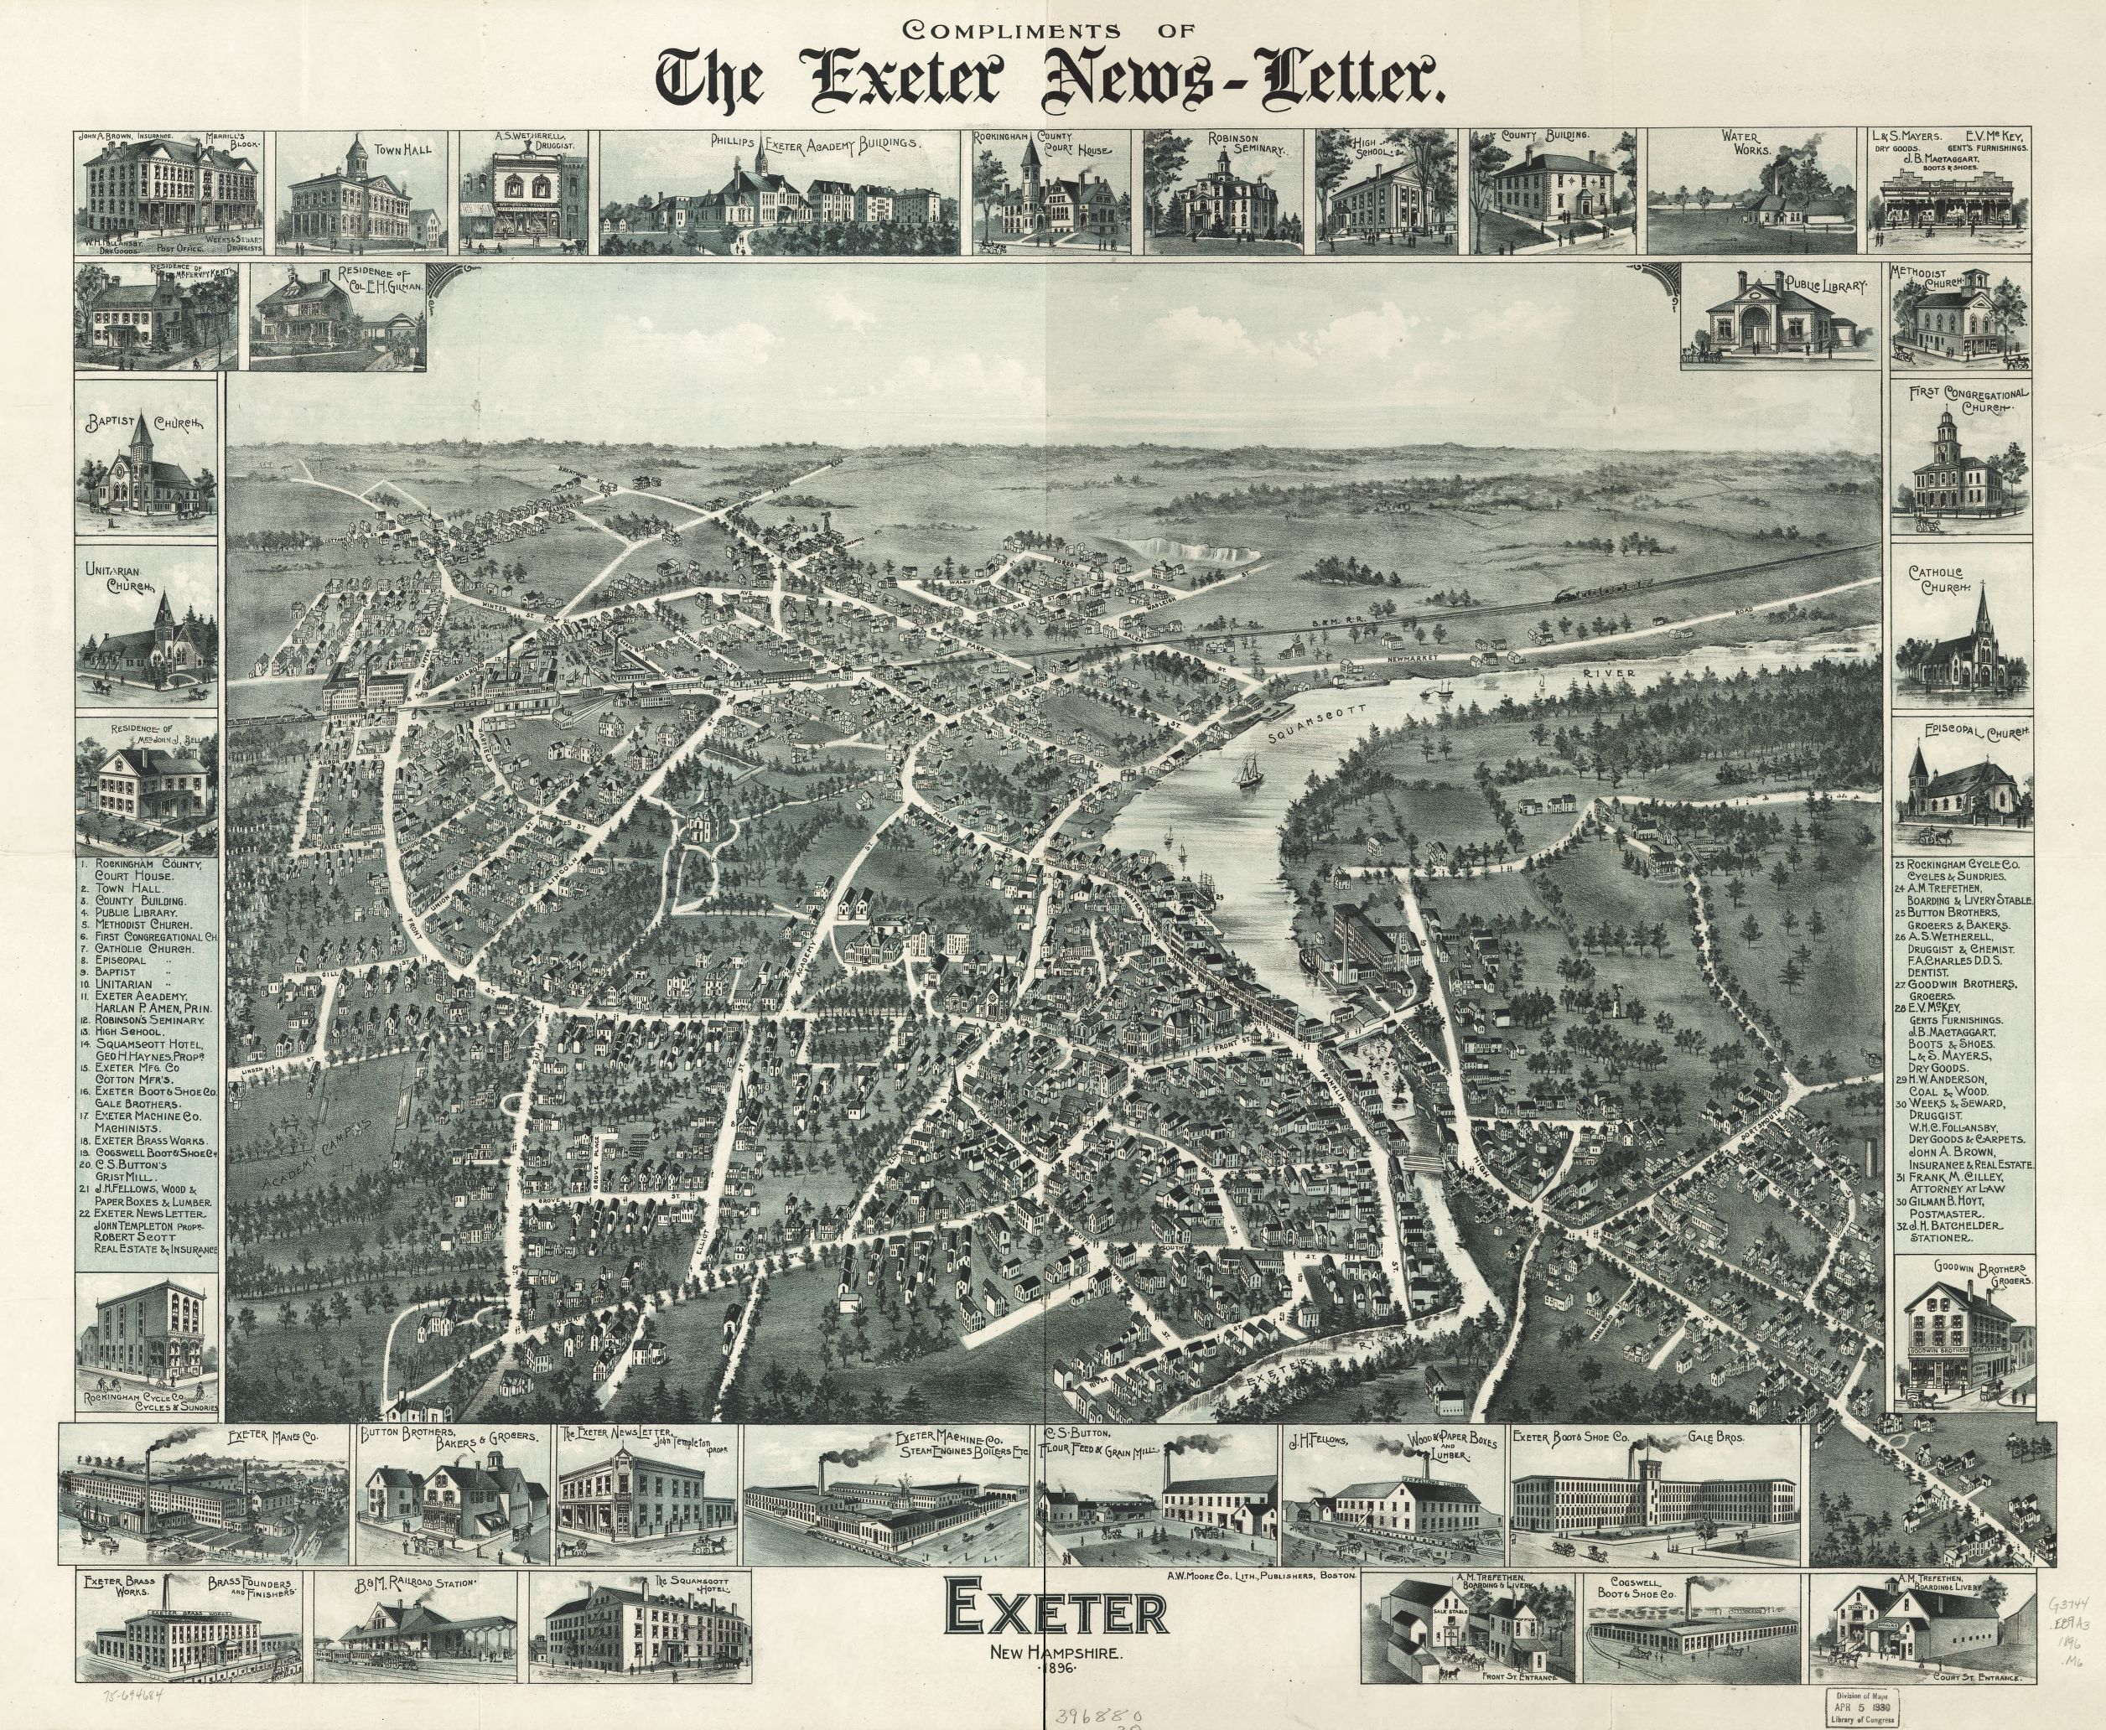
1896
1845

Slide 34
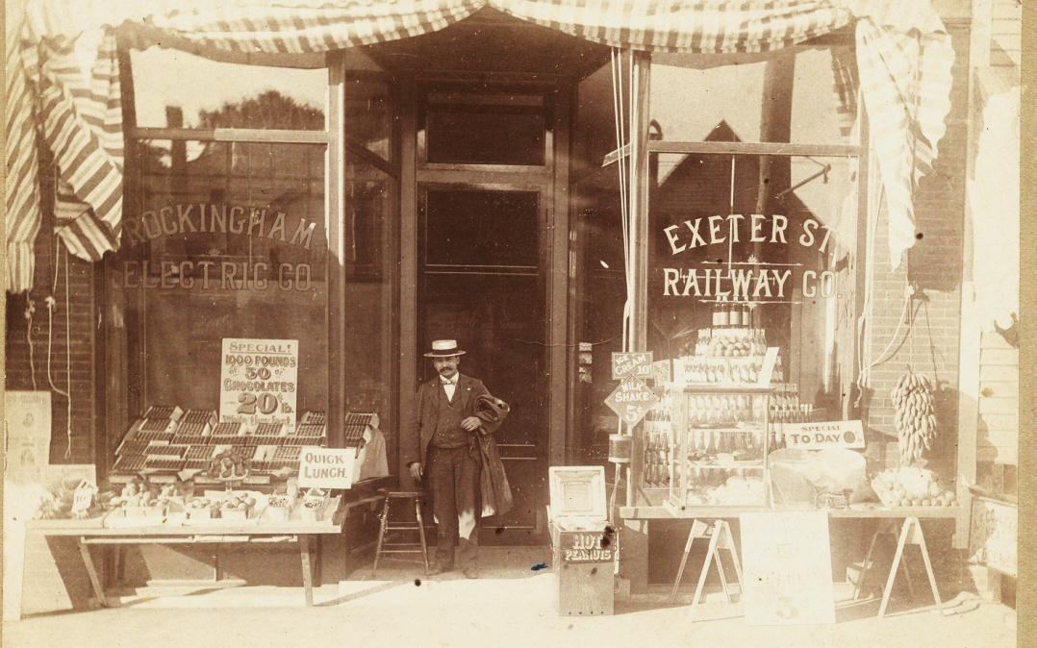
1897
Electricity Comes to Exeter
Rockingham Electric Company
Installs power lines at their own expense to show residents electricity is safe and better than gas
Start of trolley to Hampton

Slide 35
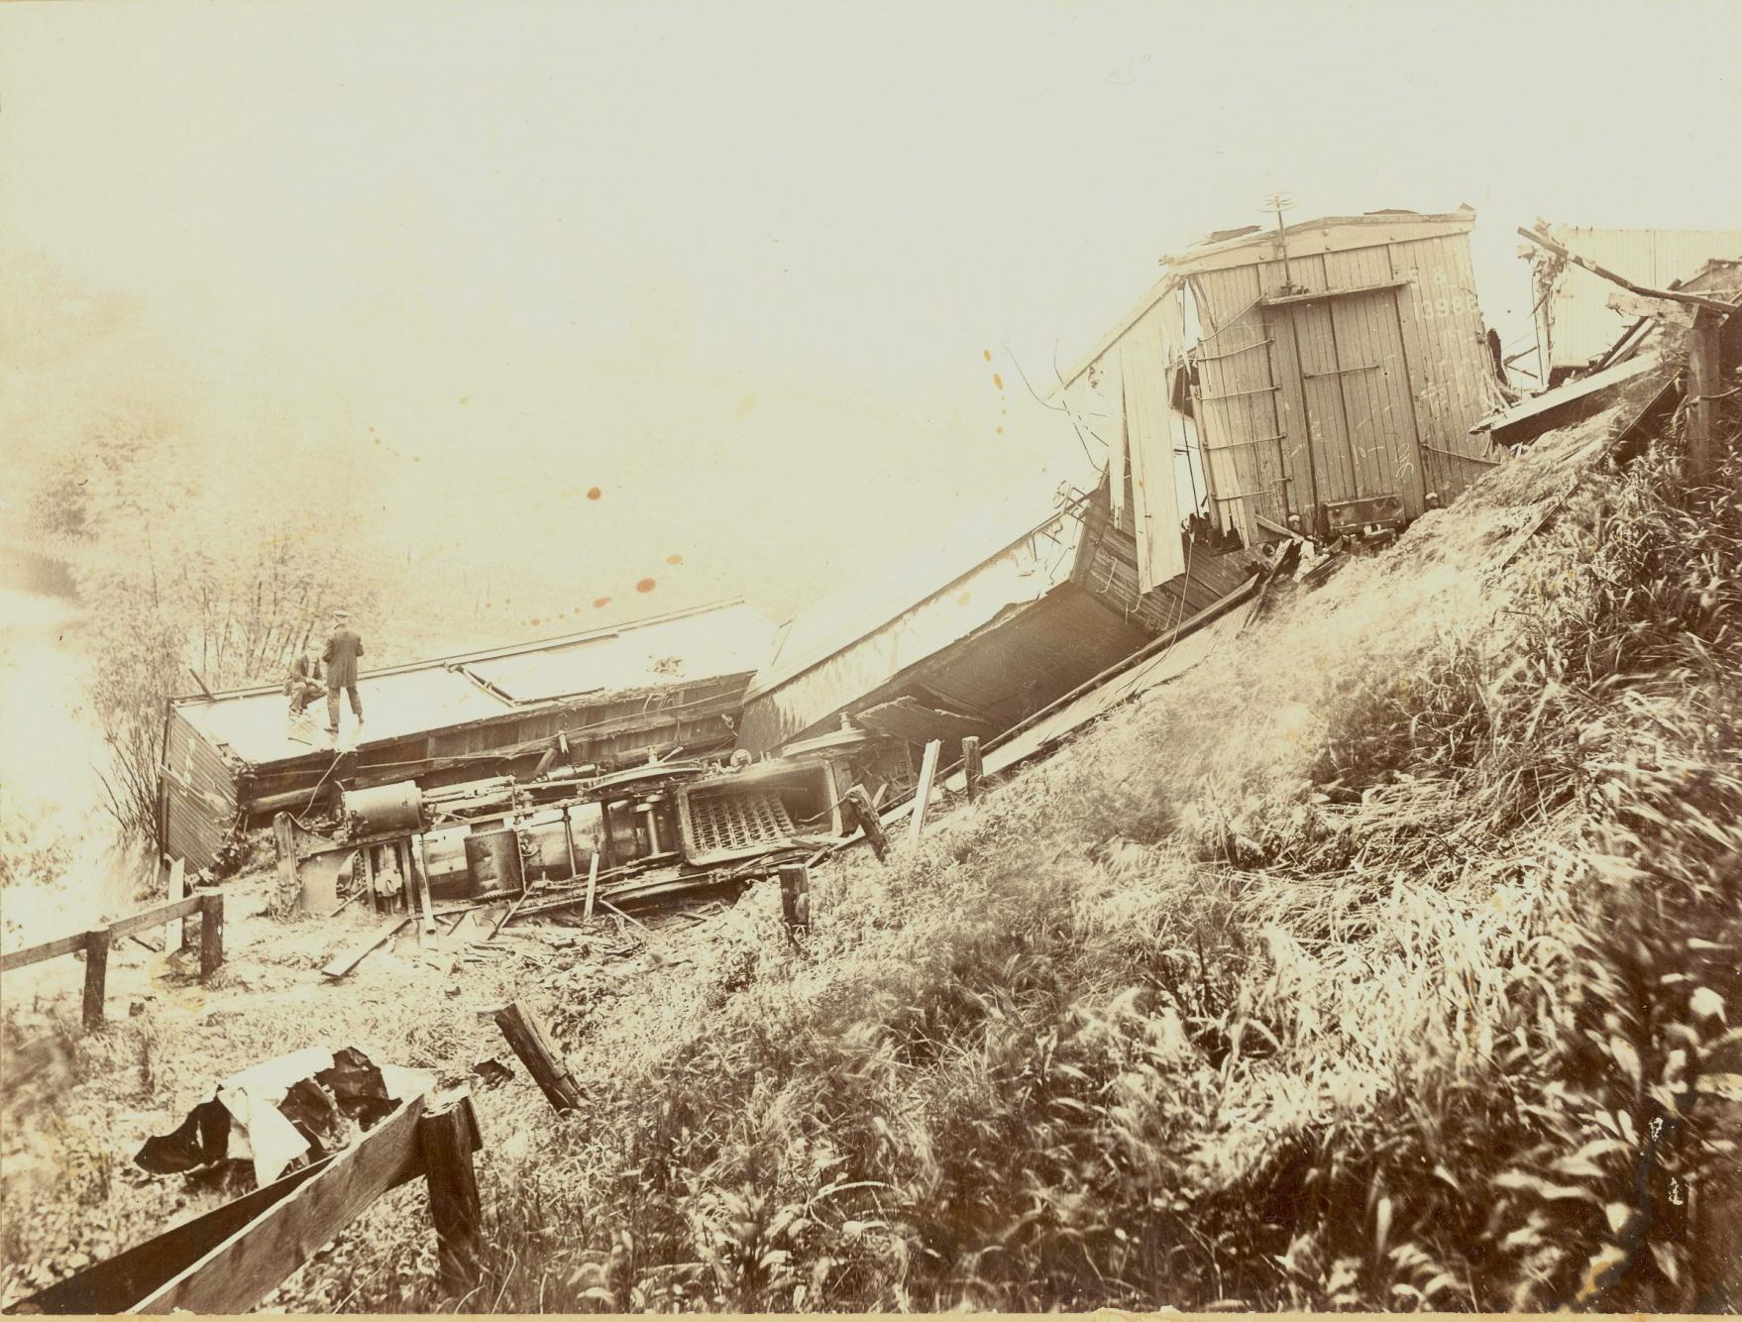
1897
Exeter Cottage Hospital opens on Pine Street
Train crash near Newfields
5 days later

Slide 36
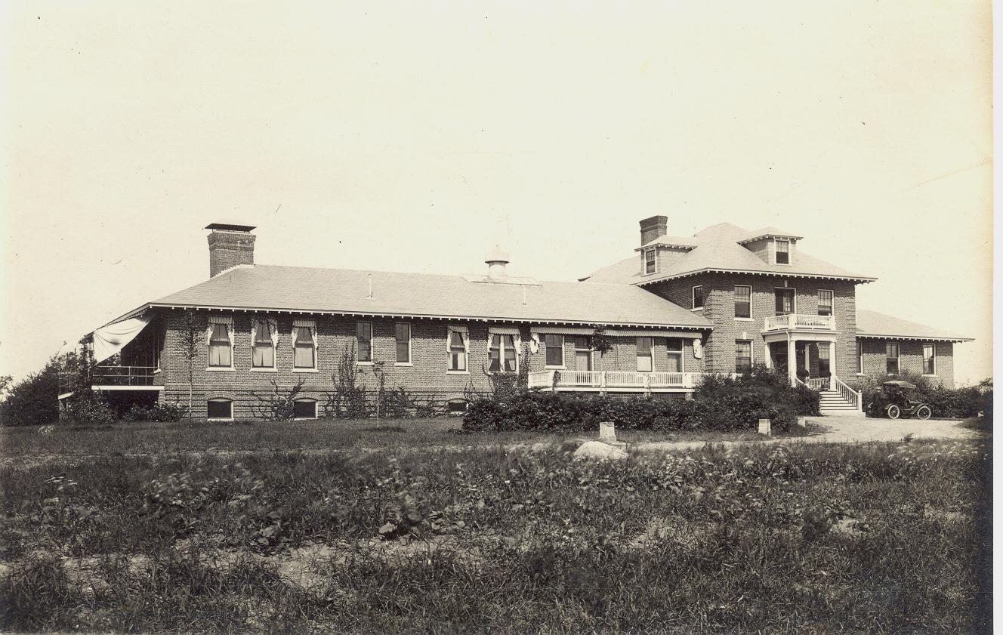
1905
First Automobile in town
1910
Exeter Cottage Hospital and nurses school on
Prospect Hill

Slide 37
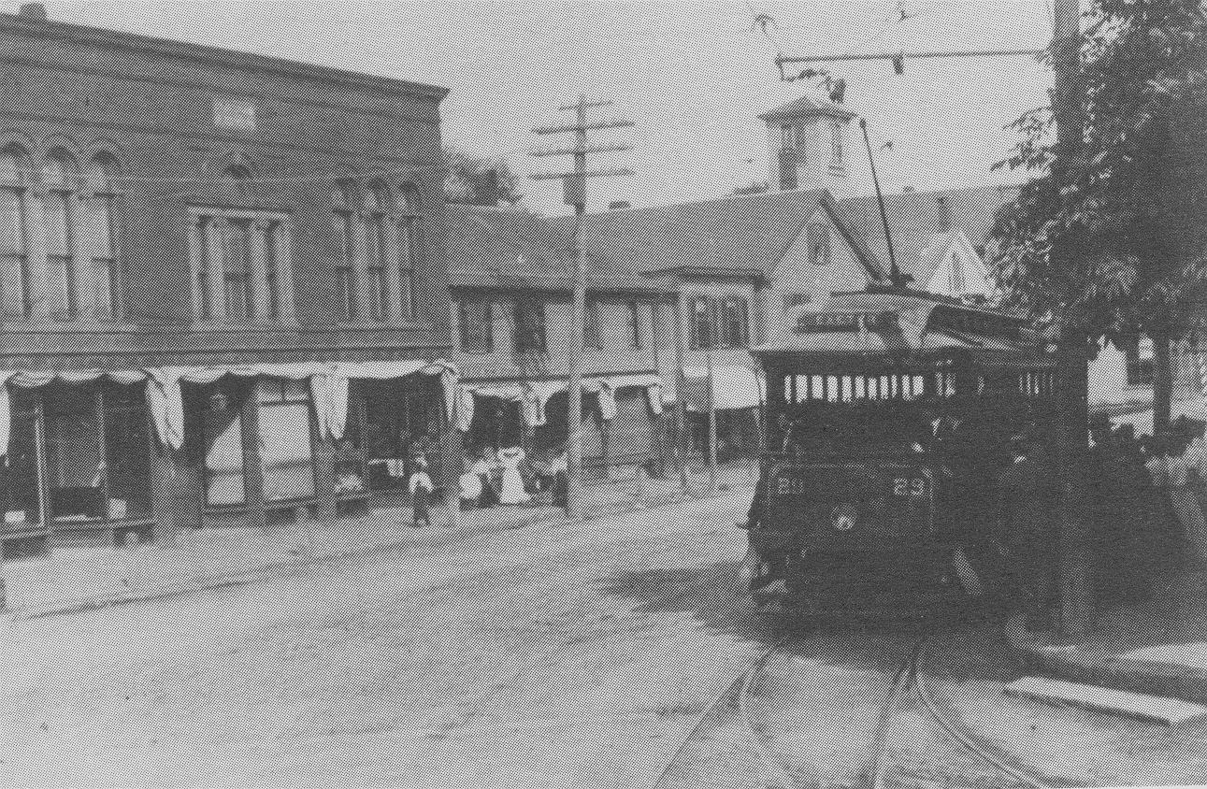
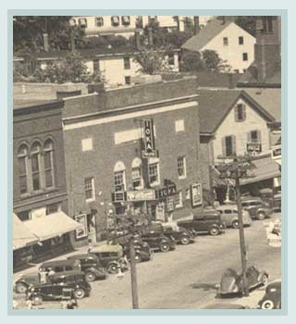
1897 – 1928
Exeter Street Railway
Service
Schooners still operating in the harbor
1915
IOKA changes the downtown

Slide 38
1913
Population 4,897
1913

Slide 39
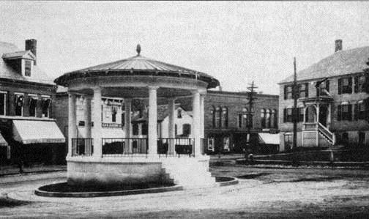
1916
Ambrose Swasey gifts Swasey Pavilion to the town
replacing seasonal wood structure
Exeter Brass Band has played in this location since its founding in 1848

Slide 40
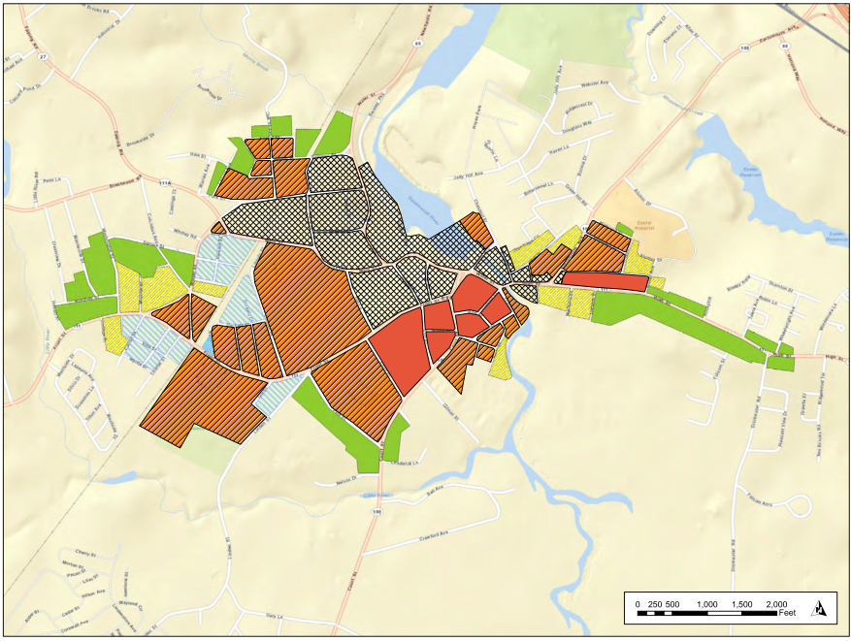
1924
Population 4,604
1929
Ambrose Swasey gifts Park to the town
1924

Slide 41
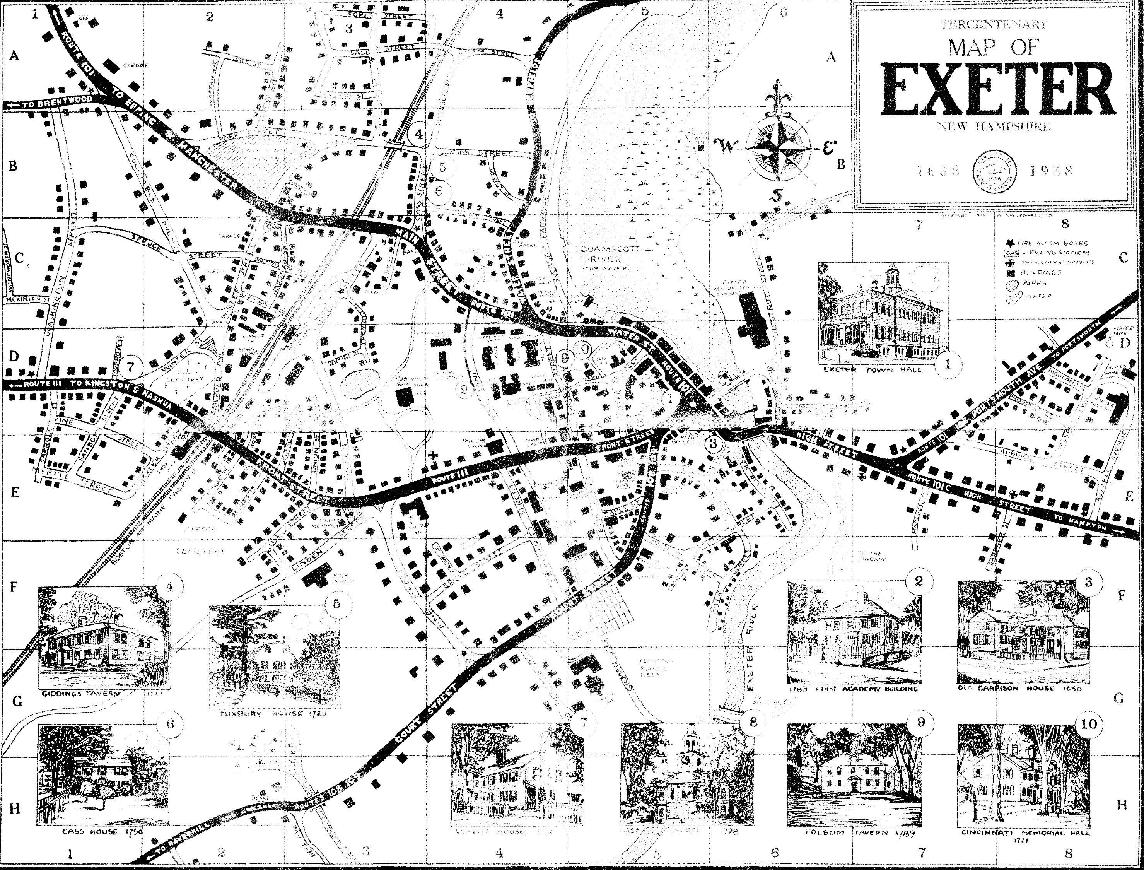
1938
1938
Population 5,398

Slide 42
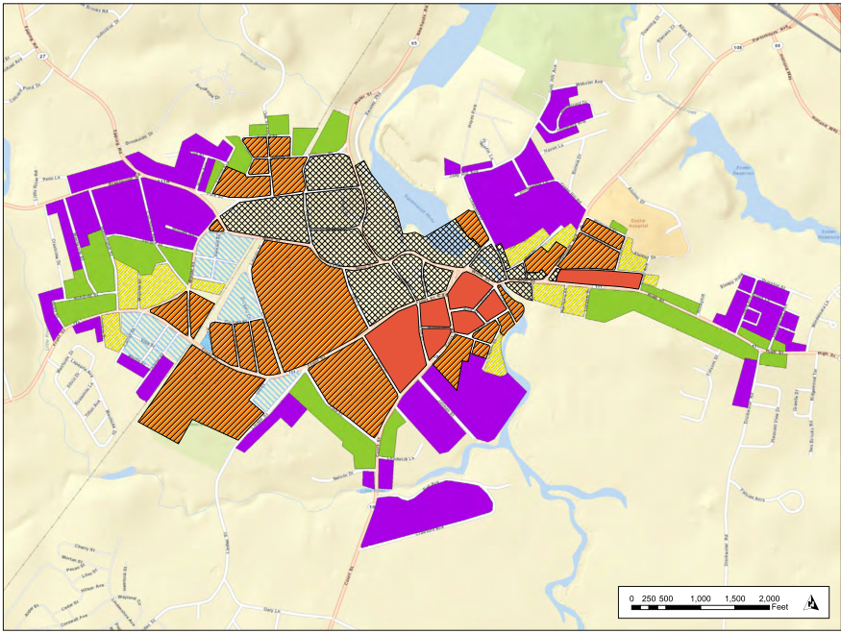
1950
Population 5,664
1950

Slide 43
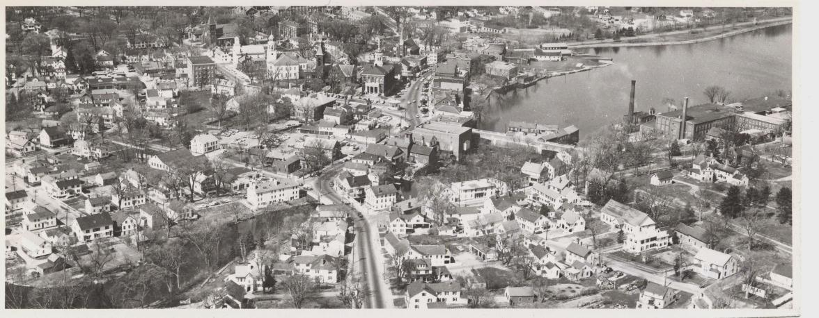
Circa 1950

Slide 44
A March Through History

Slide 45
1802
1802

Slide 46
1845
Population 3,329
1845

Slide 47
1874
Population 3,347
1874

Slide 48
1885
Population 3,640
1885

Slide 49
1892
Population 4,282
1892

Slide 50
1913
Population 4,897
1913

Slide 51
1924
Population 4,604
1924

Slide 52
1950
Population 5,664
1950

Slide 53
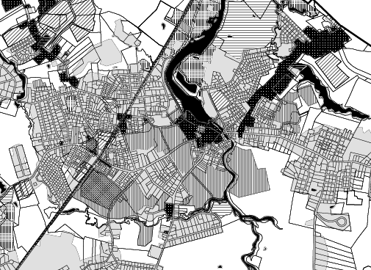
2010
Population 14,300

Slide 54
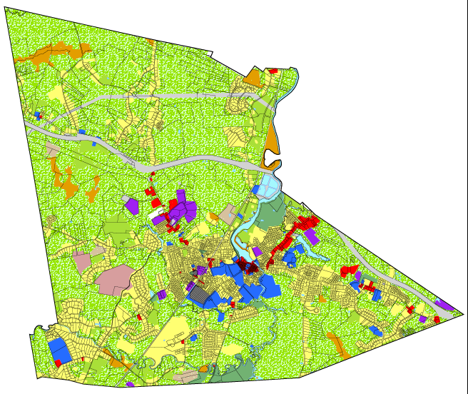
2002
Population 14,300

Slide 55
With thanks to:
Exeter Heritage Commission
Peter Michaud
John Merkle
Mary Dupré
Jaime Lopez
Peter Smith
Kathy Corson, Planning Bd. Rep
Ron Schutz, HDC Rep
Julie Gilman, Selectmen’s Rep
Bruce Harvey Consulting
NH Division of Historical Resources
Photographs Courtesy of the Exeter Historical Society
“History of Exeter 1683-1888” Charles H. Bell
“History of Exeter 1888-1988” Nancy C. Merrill
“Images of America, Exeter” Carol Walker Aten
Made possible by:
NH DHR Certified Local Government Grant

Slide 56
“The activity that is the subject of this video presentation has been financed in part with federal funds from the National Park Service, Department of the Interior, through the New Hampshire Division of Historical Resources. However, the contents and opinions do not necessarily reflect the views or policies of the Department of the Interior, nor does the mention of trade names or commercial products constitute endorsement or recommendation by the Department of the Interior.”

Slide 57
A March Through History

