Slide 1
Lincoln Street Phase II Improvement Project
Public Input Meeting
June 27, 2017

Slide 2
Meeting Purpose:
Understand the Context of the Corridor
  Critical for designing a street that functions well in its surroundings
We need your input:
  Issues
  Concerns
  Desires
Kickoff Conceptual Design

Slide 3
Anticipated Project Schedule
June 2017 Public Input Meeting
July/Aug 2017 Conceptual Design
Sept 2017 Public Meeting – Conceptual Design Alts
Sept – Dec 2017 Final Design
February 2018 Bid Project
April – Dec 2018 Construction

Slide 4
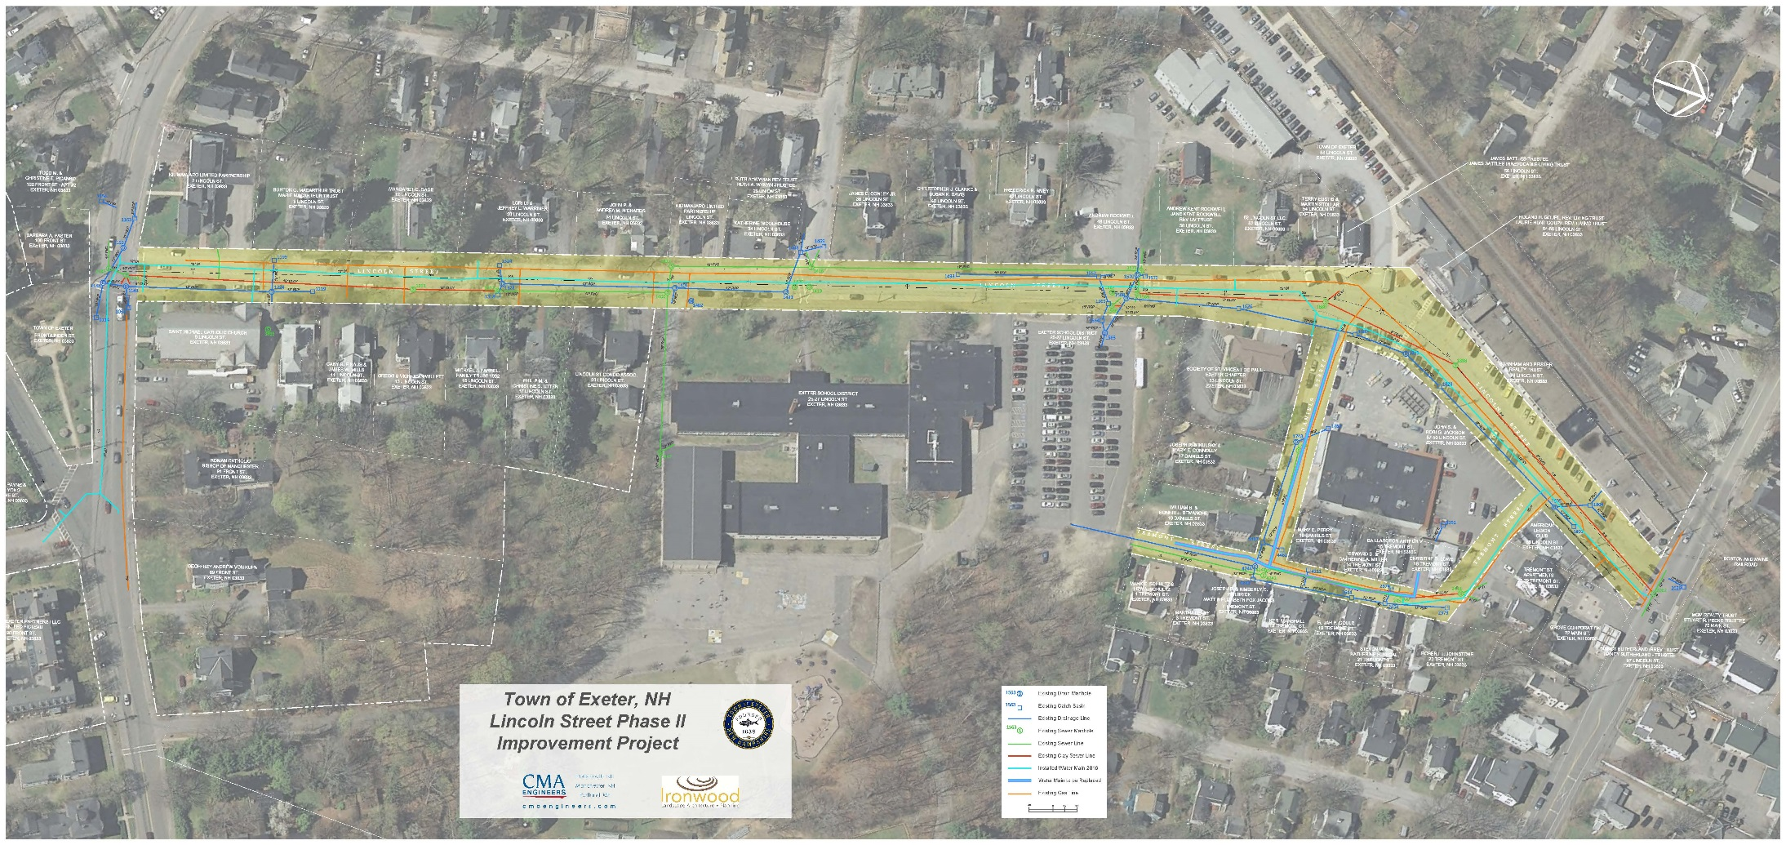
Project area
Lincoln Street

Slide 5
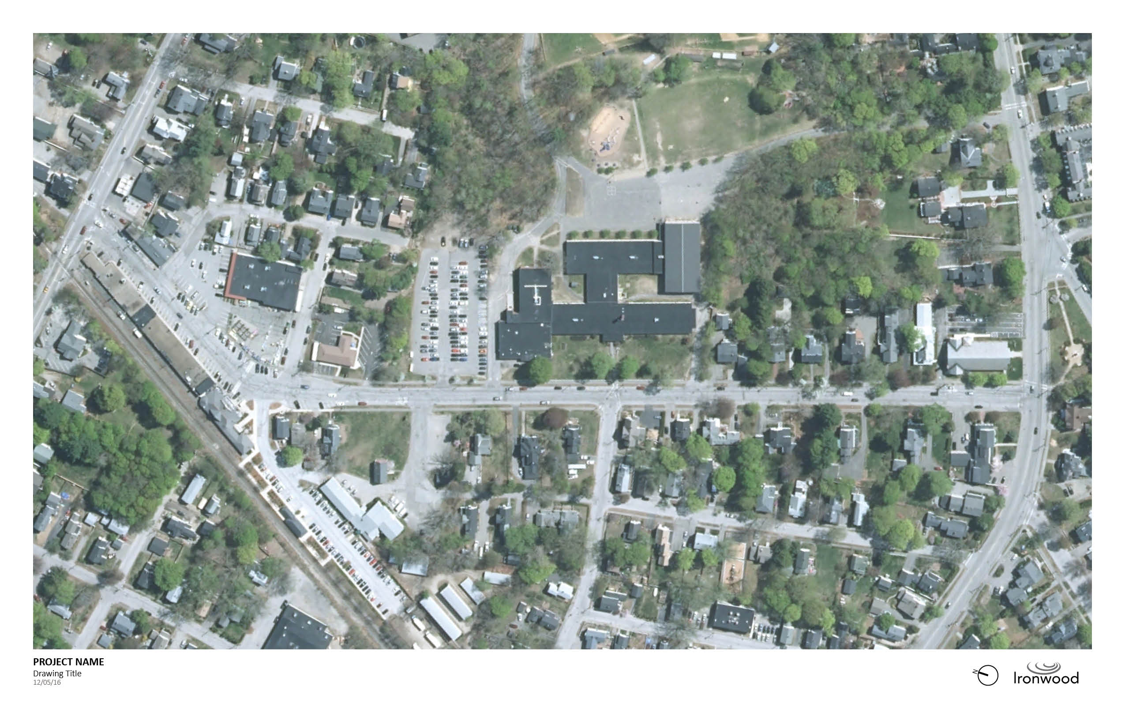

Project Area
Union Street
Garfield Street
Lincoln Street
Front Street
Main Street
N
W
E
S

Slide 6
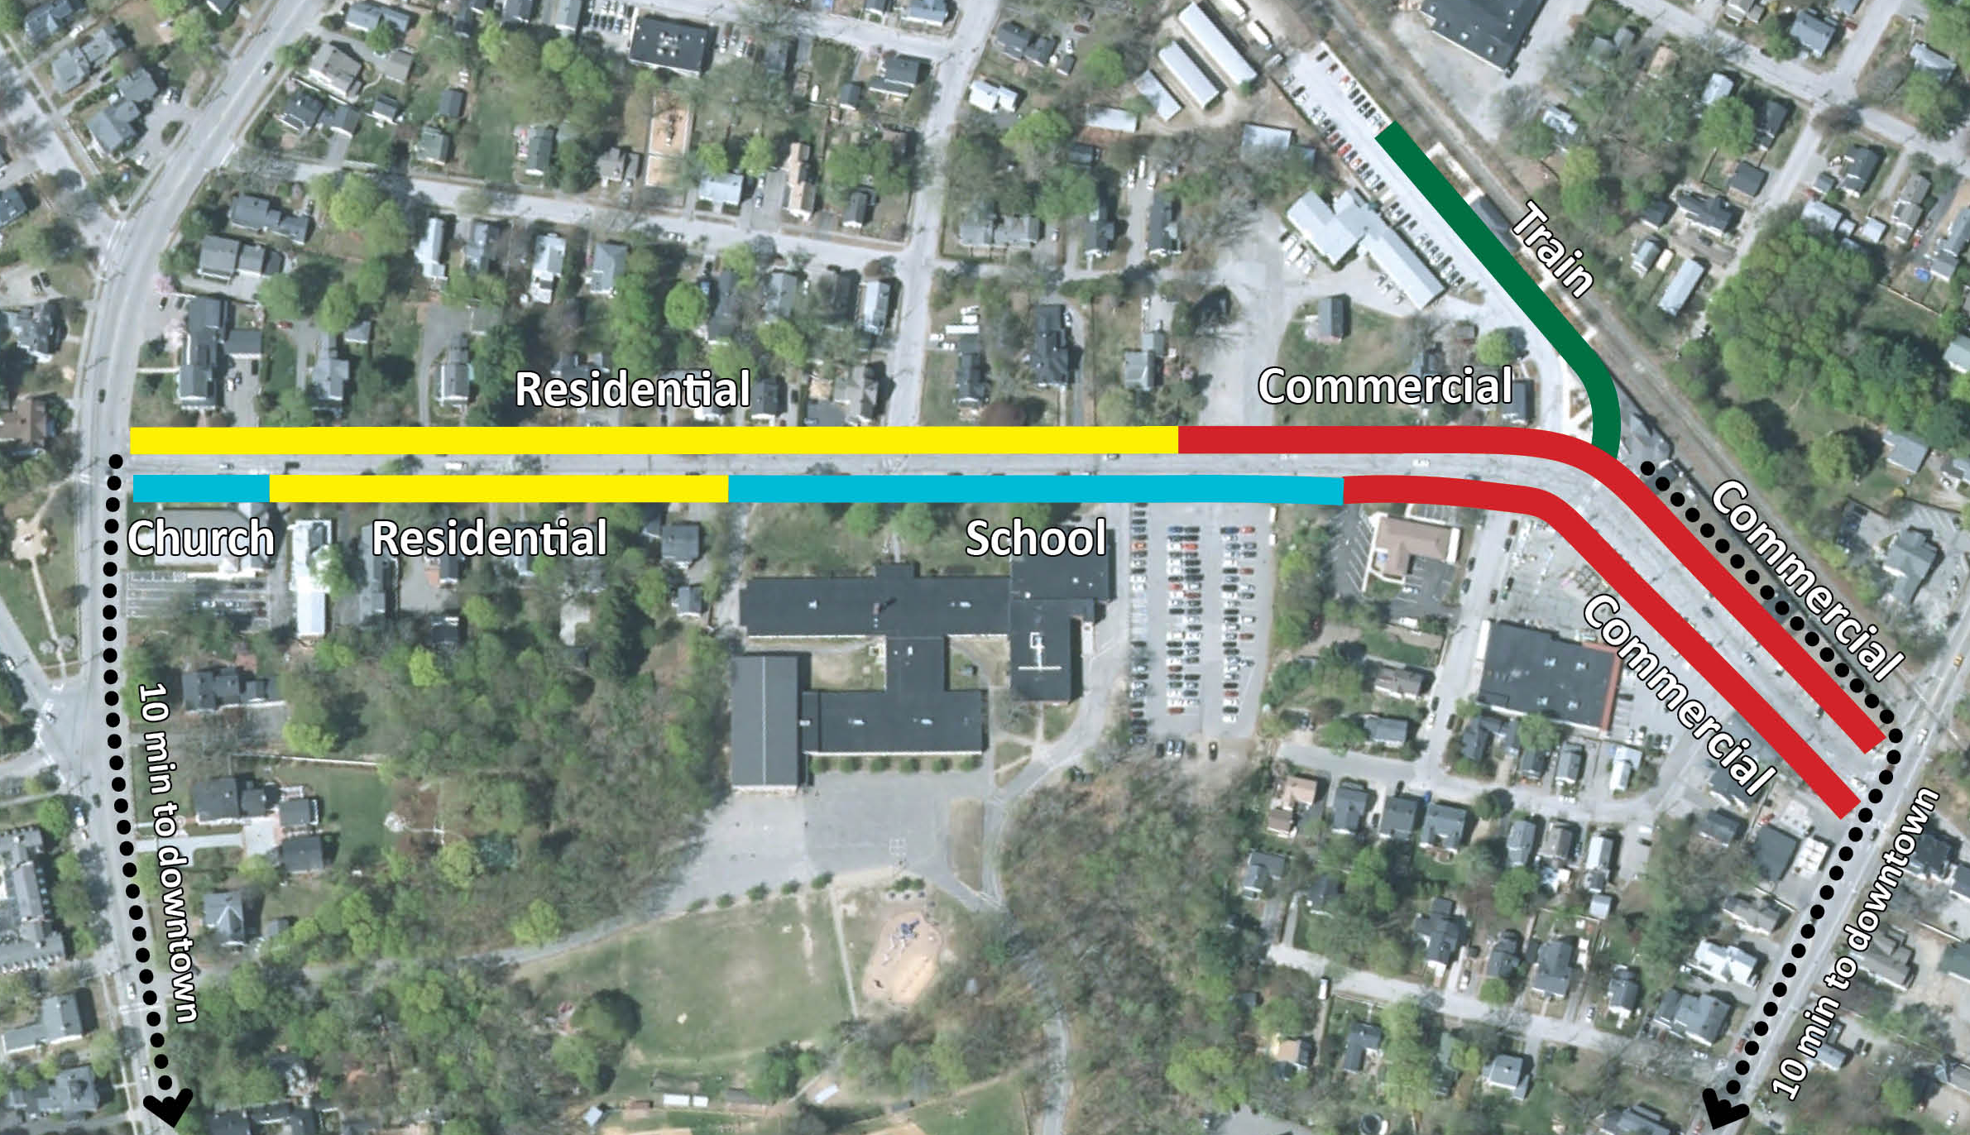
Corridor Character
N
W
E
S

Slide 7
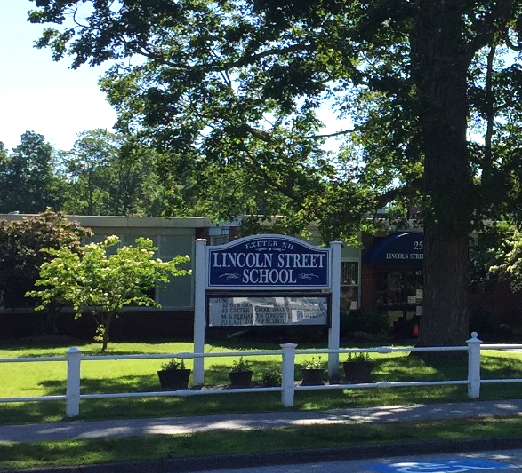
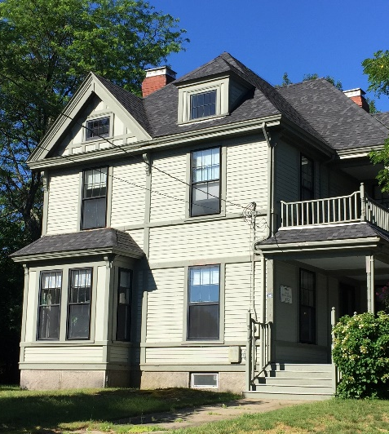
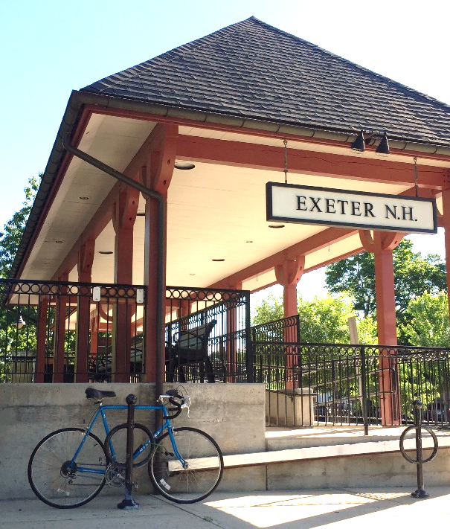
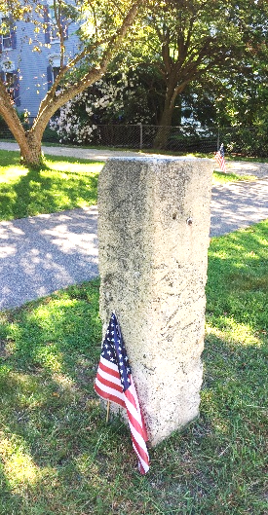
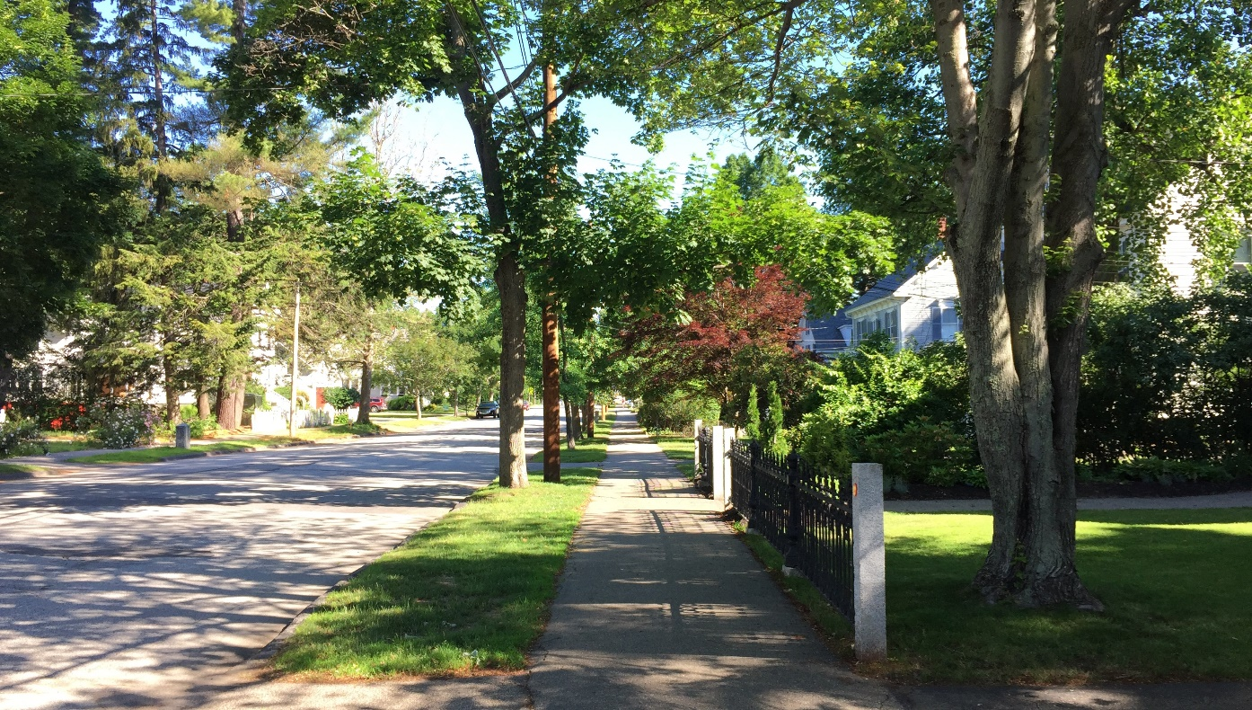
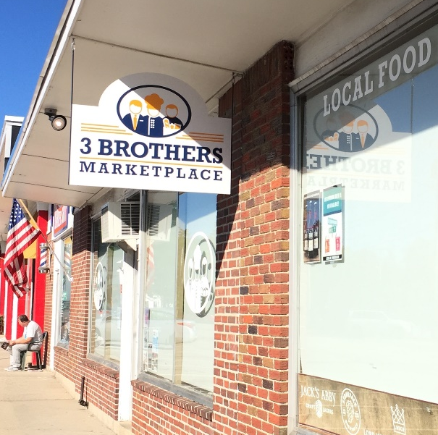
Corridor Character

Slide 8
Anatomy of a streetscape
Lincoln Street

Slide 9
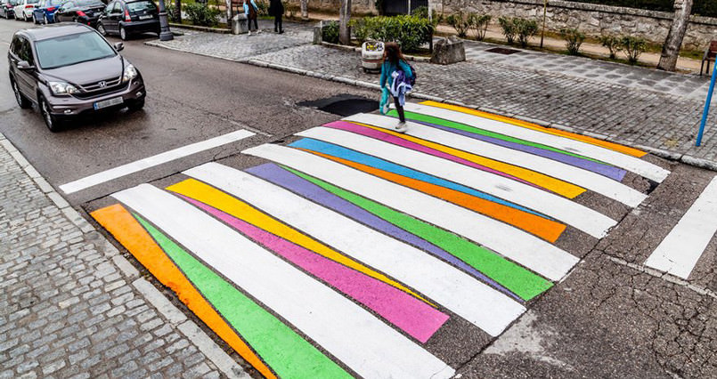
Complete Street Design Standards
Complete Streets are designed for everyone.
They enable safe access for all users of all ages and physical abilities including:
pedestrians
bicyclists
motorists
service vehicles
transit riders

Slide 10
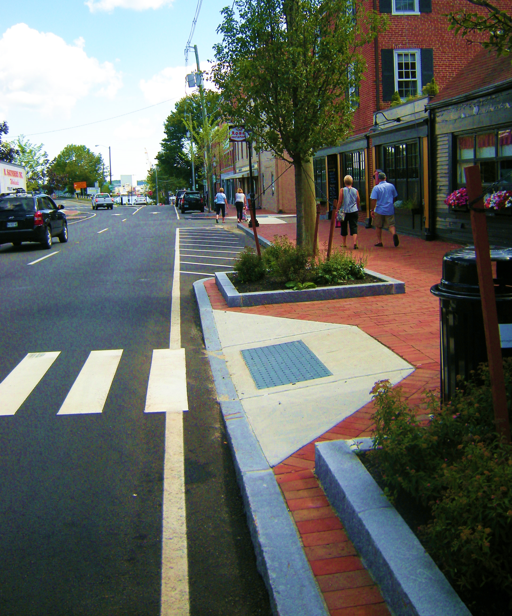
Safety Measures
Pedestrian safety
  Ample Sidewalks
  ADA Ramps
  High Visibility Crosswalks
  Bump-outs
  Adequate Lighting
Traffic safety
  Movement, turning, visibility
  Bicycle awareness, signage, bike lanes where space permits
  Service vehicle movement, access
  Parking
  Clear signage and wayfinding

Slide 11
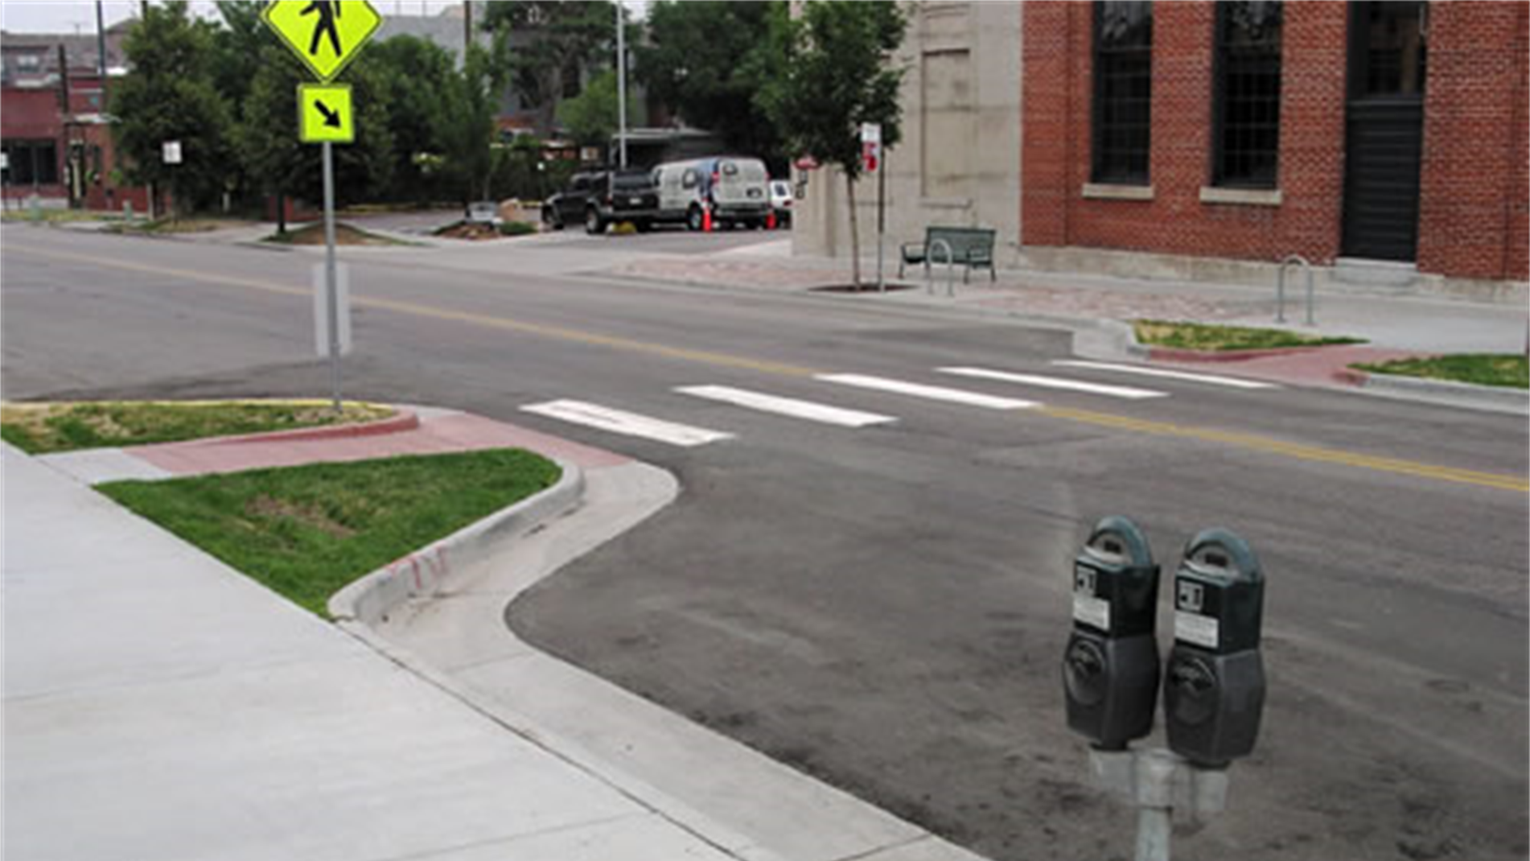
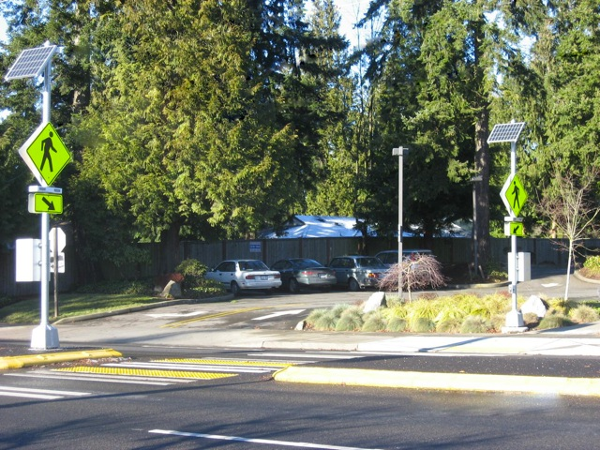
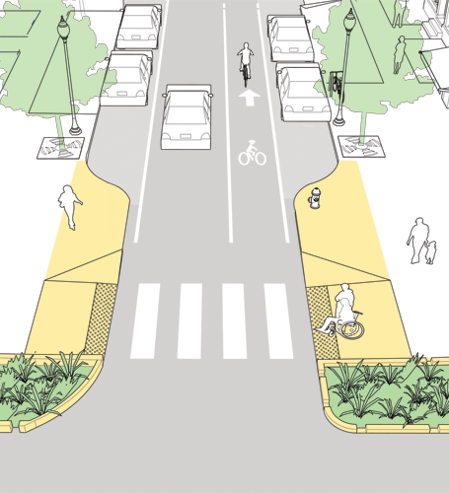
Pedestrian Crossing Improvements
Bump - Outs
Reduced crossing distance
Enhanced visibility for both pedestrians and roadway users
More space for signs & amenities
Effective traffic calming
Curb Ramps
Improved access for those with mobility or visibility disabilities
RRFB’s

Slide 12
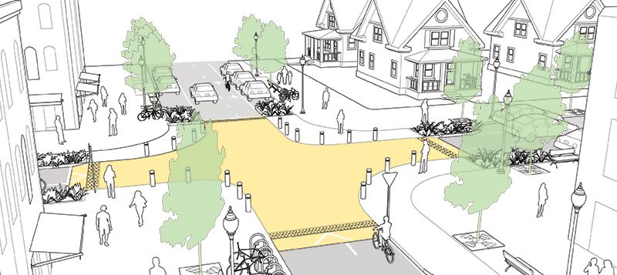
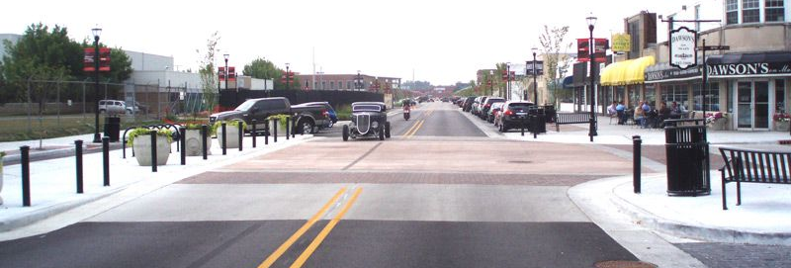
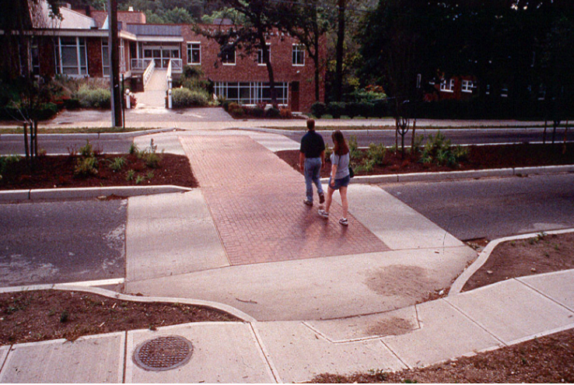
Pedestrian Crossing Improvements
Raised Intersections/
Crossings
Reduced crossing distance
Enhanced visibility for both pedestrians and roadway users
More space for signs & amenities
Effective traffic calming
Source: NATCO

Slide 13
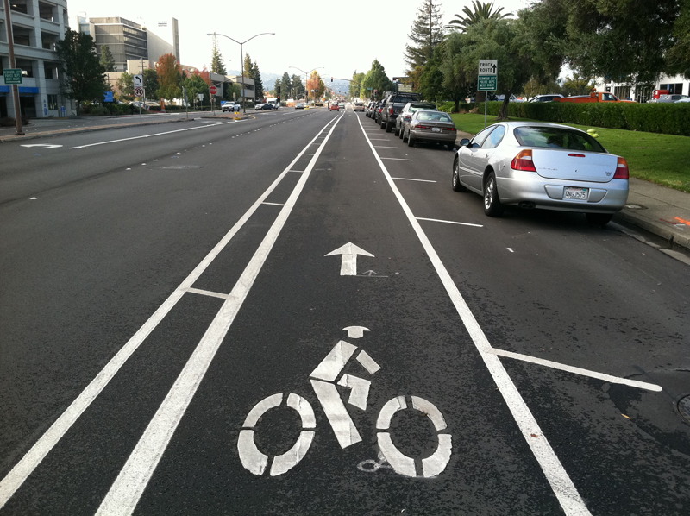
Bicycle Improvements
Bike Lanes
Safety & accessibility for bicyclists
Roadway/Pedestrian buffer
Encourages bike usage
Source: NATCO

Slide 14
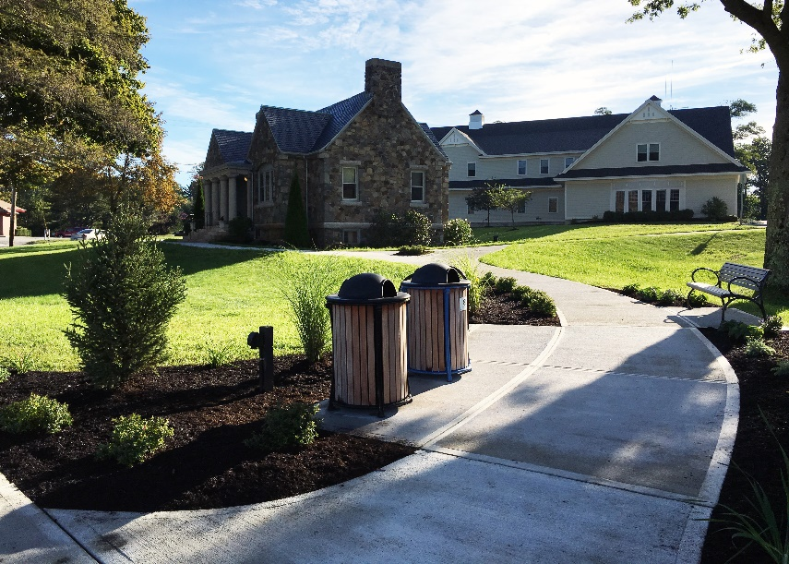
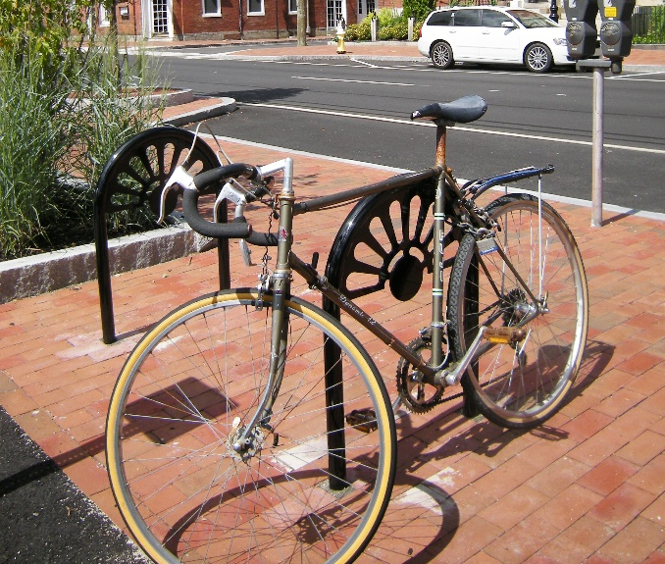
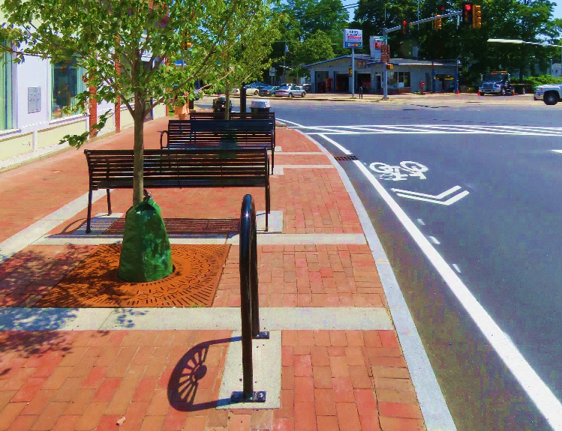
Streetscape & Placemaking Amenities
Benches
Litter Receptacles
Bike Racks
Light Poles
Bollards
Fences
Signage and wayfinding
Pocket Parks (small spaces designed for people to linger, socialize, relax, enjoy, eat, and meet-up)

Slide 15
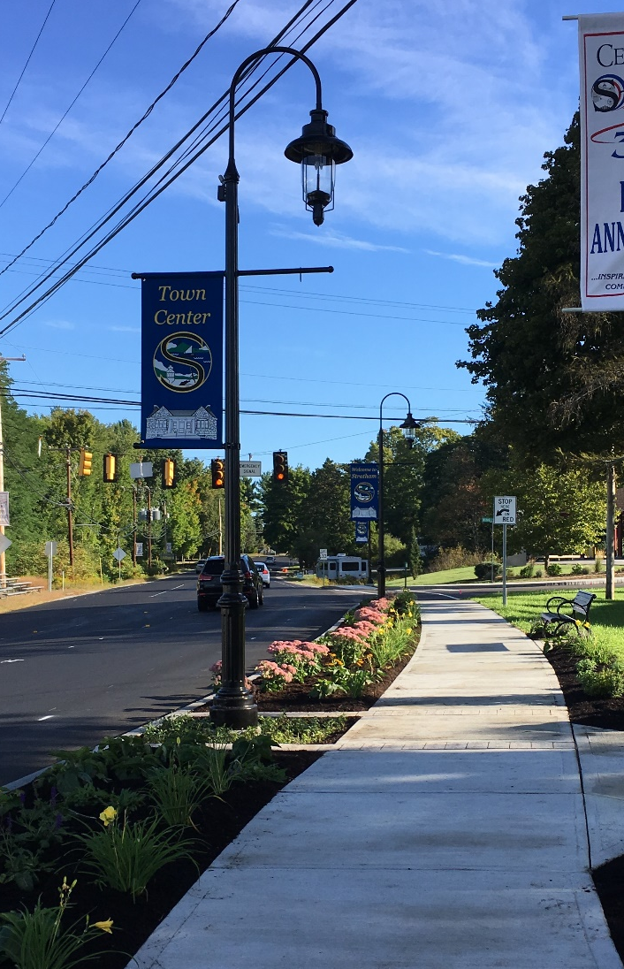
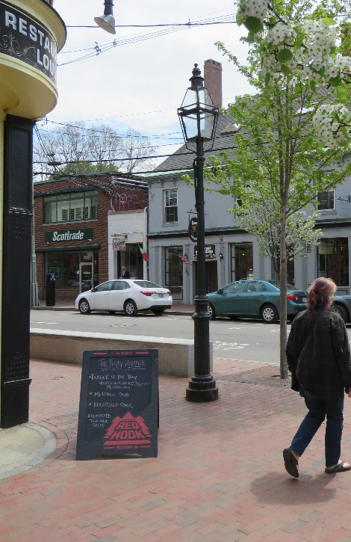
Lighting
Street Lights
Improve visibility of signs, crosswalks, road markings
Create a safer and secure feeling environment
Reinforce a sense of place

Slide 16
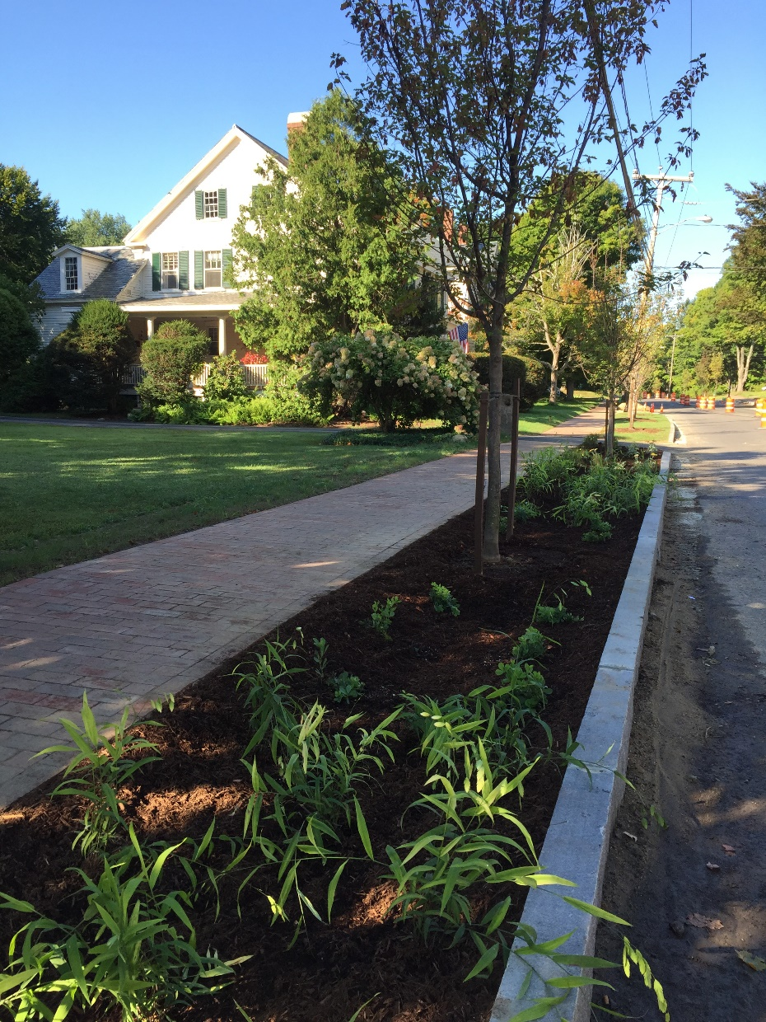
Street Trees and Planted Areas
Enhance curb appeal
Create shade
Provide habitat, biodiversity, and ecosystem services
Buffer between pedestrians and motor vehicles
Reduced storm water runoff

Slide 17
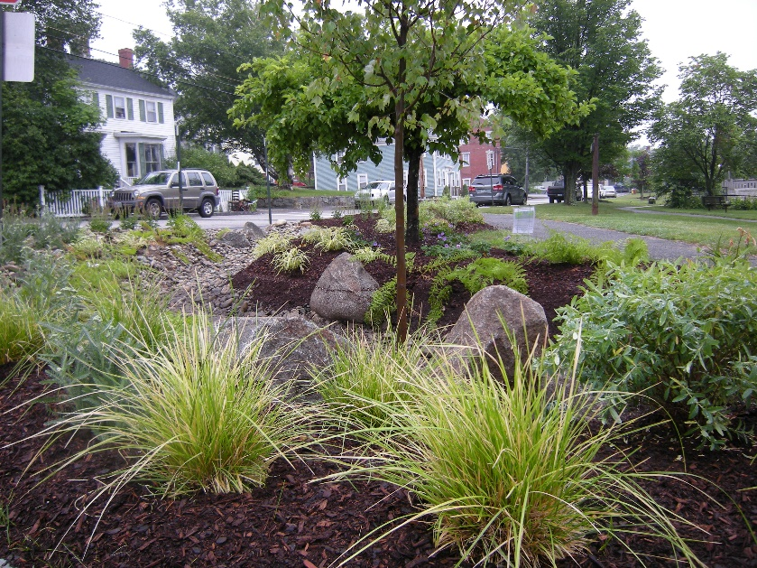
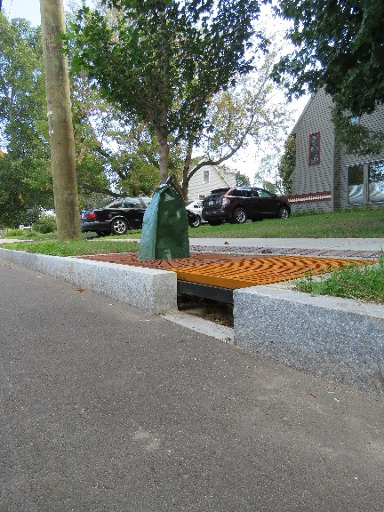

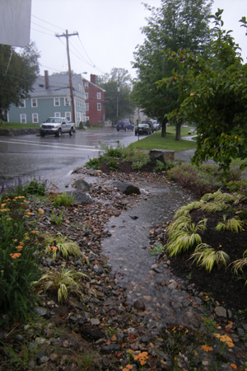
Green Stormwater Management
Bioretention Treeways
Treebox Filters
Curbside Rain Gardens

Slide 18
Past design efforts
Lincoln Street

Slide 19
Plan NH Charette
(October 2010)
Identified Goals:
Protection and Enhancement of Neighborhood Identity
Preservation of Neighborhood Shops and Services
Protection and Enhancement of Pedestrian Safety
Improvements to Traffic Circulation
Recognition and Treatment of the Lincoln Street Station as a “gateway” and ‘welcome center” for the Exeter Community
Treatment of Drainage and Stormwater Management Issues

Slide 20
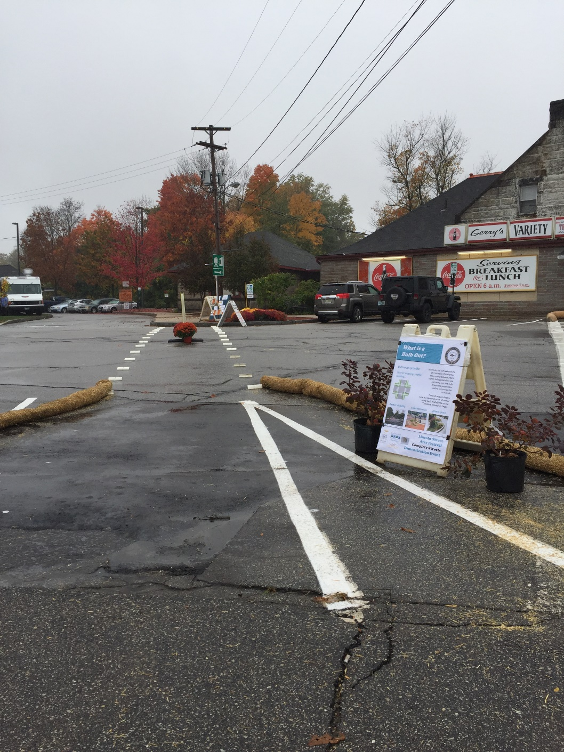
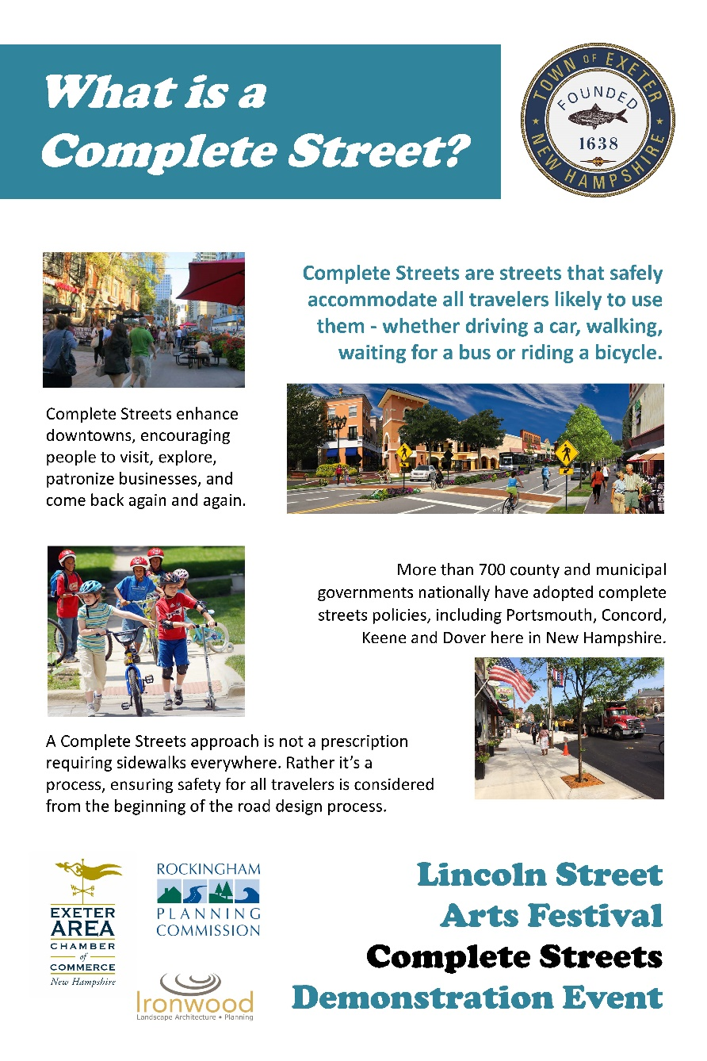
Complete Streets Demonstration
(October 2016)

Slide 21
Draft Project Goals
Implement Complete Street Design
Utility & Stormwater Improvements
Create a gateway to Exeter from the Train Station
Provide opportunities for businesses to flourish
Motivate property owners to invest
Reduce the impact of Lincoln Street on wetlands and rivers
Notes:
Overarching objective: develop compete streets alternatives that address, pedestrian facilities, bike accommodations, parking, and traffic congestion
As we work through the design process with the Town and the Public, develop more specific objectives based on:
Better understand the context of the corridor through stakeholder input
Identify opportunities and constraints
Complete street approach: there will be tradeoffs – balancing competing interests

Slide 22
Public Input
What do we need to know?
What are the issues?
What are the concerns?
What would you like to see?

Slide 23
Next Steps
Send us your comments (mail or email)
Meeting notes
Refine project goals
Conceptual Design Alternatives
Public meeting to present design alternatives

Slide 24
Keep in Touch
Jennifer Mates, P.E., Assistant Town Engineer
(603) 418-6431
jmates@exeternh.gov

