Slide 1
Informational Meeting
Front Street at Pine and Linden Streets
-----
Intersection
Improvement Project
February 17, 2026

Slide 2
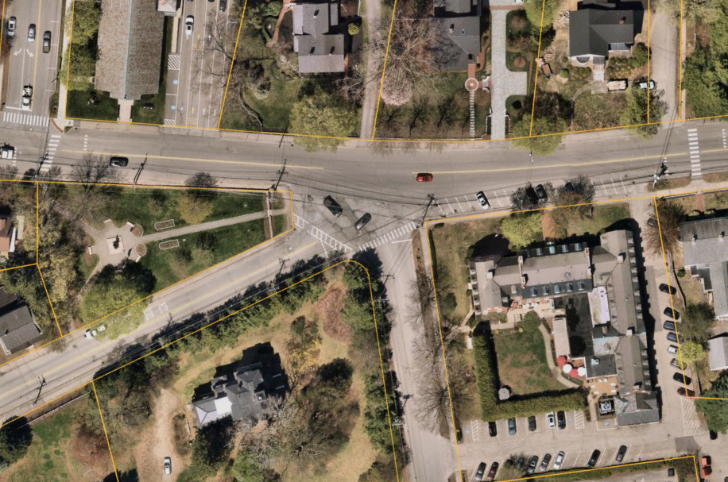
Front Street at Pine and Linden Streets
Lincoln St
Front St
Linden St
Pine St
Concerns:
-Difficulty entering Front St from side streets
-Awkward, wide-open “mixing zone” adds to driver confusion
-Pedestrian crossings are long and skewed, and ramps are not ADA compliant

Slide 3
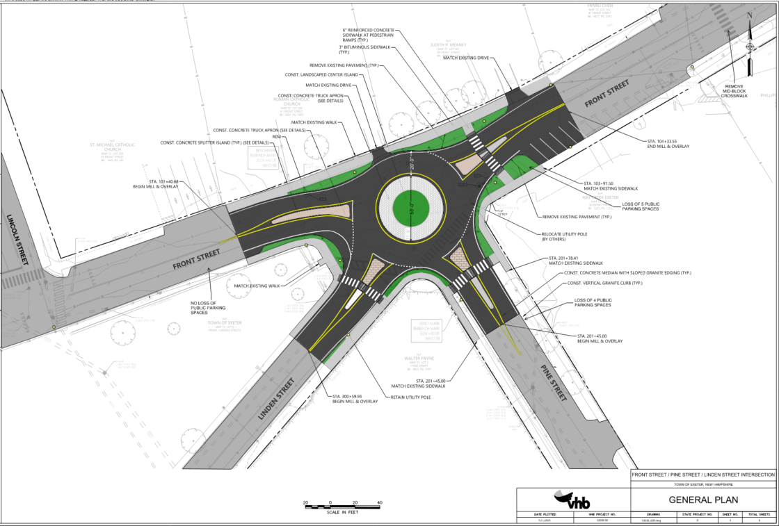
Front Street at Pine and Linden Streets

Slide 4
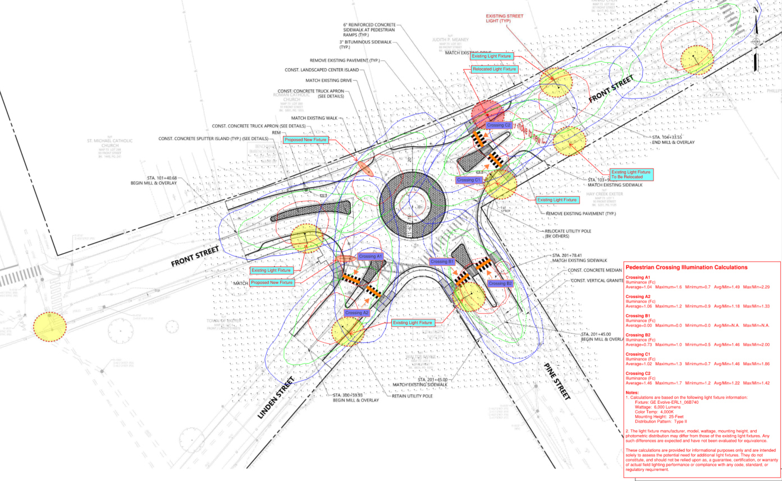
Front Street at Pine and Linden Streets

Slide 5
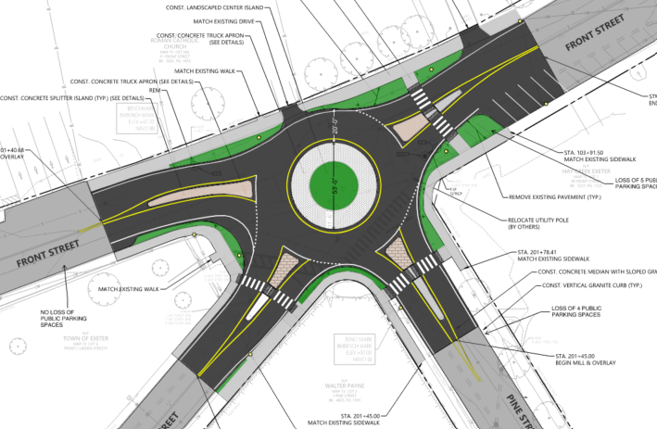
Front Street at Pine and Linden Streets
93’ Dia.

Slide 6
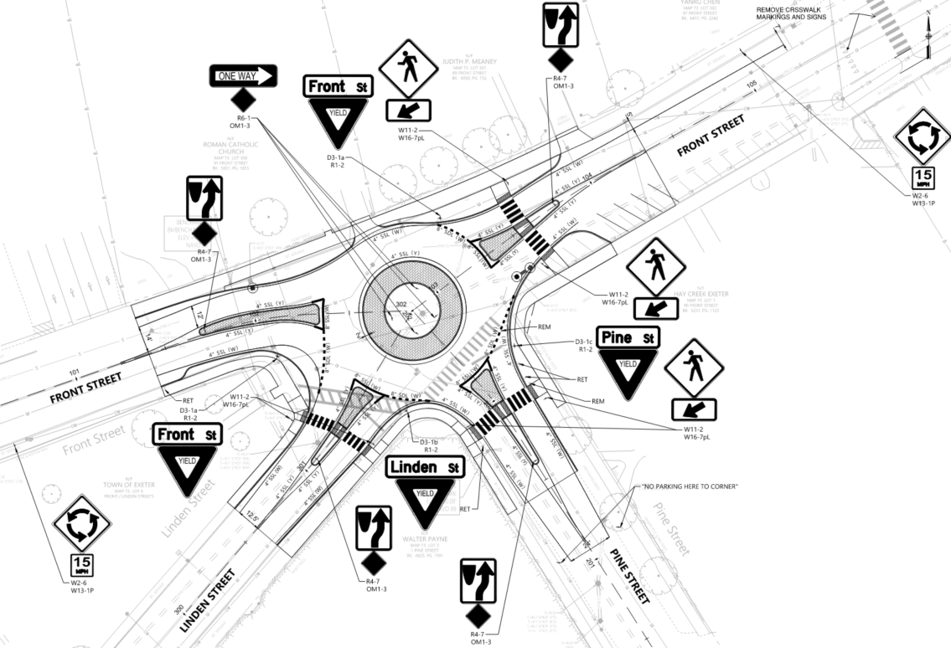
Front Street at Pine and Linden Streets

